Slide 1
The EIC Detector R&D Program
Status, Impact, and Needs
See also plenary talks by: Maxim Titov (MPGDs), Tom Hemmick (TPC), Paolo Cameron (MAPS) and Parallel 1 on Friday.
Thomas Ullrich, BNL/Yale
EIC User Meeting Trieste
July 20, 2017

Slide 2
EIC Detector R&D Efforts
Generic EIC Detector R&D Program (covered here)
Other substantial efforts with impact on EIC
Laboratory Directed Research & Development Programs (LDRDs) at National Labs in the US (BNL, JLAB, ANL, …)
CERN supported detector R&D program with partial match with EIC needs (e.g. RD51 Micro-Pattern Gas Detectors Technologies) → Maxim’s talk
LHC Experiments R&D for phase-I upgrades, especially ALICE (TPC, ITS, SAMPA, …) and LHCb (RICH, trigger less DAQ, electronics, …). Now in production, R&D finished.
R&D at Belle-II and Panda (crystals, DIRC, …)
ILC related R&D (TPC, …)
Rate and precision requirements compatible
Less emphasis on forward/backward instrumentation
Notes:
DIRC = Detection of Internally Reflected Cherenkov light

Slide 3
Generic Detector R&D for an EIC
In January 2011 BNL, in association with JLab and the DOE Office of NP, announced a generic detector R&D program to address the scientific requirements for measurements at a future EIC
Goals of Effort
Enable successful design and timely implementation of an EIC experimental program
Quantify the key physics measurements that drive instrumentation requirements
Develop instrumentation solutions that meet realistic cost expectations
Stimulate the formation of user collaborations to design and build experiments
Program coordinator 2011-2014: Tom Ludlam
2014-present: TU

Slide 4
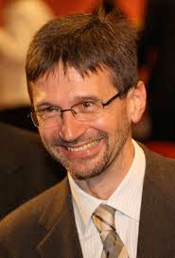
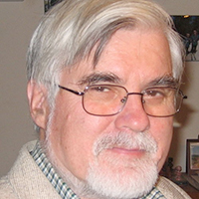
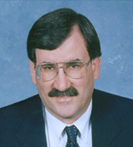
Generic Detector R&D for an EIC
Funded by DOE through RHIC operations funds: ~$1M/year
Program explicitly open to international participation
Key to success: Standing EIC Detector Advisory Committee consisting of internationally recognized experts in detector technology and collider physics
Meets twice a year, funding limited to one year (FY)
~January: Review of ongoing projects
~July: Review and new proposals*
Current: Marcel Demarteau** (ANL), Carl Haber (LBNL), Peter Krizan (Ljubljana),
Ian Shipsey (Oxford), Rick Van Berg (UPenn), Jerry Va’vra (SLAC), Glenn Young (JLab)
Retired:
Robert Klanner (Hamburg),
Howard Wieman (LBL)
**Chair
* During 2011-2014 new proposals were also accepted in the Winter meeting
Notes:
You should state that the program is currently funded out of RHIC Operations funds and not additional funds that come to BNL.

Slide 5
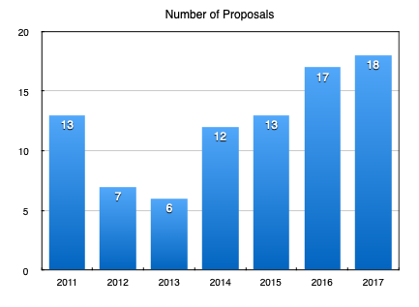
EIC Detector R&D Program in Numbers
FY18: Record participation this time (expected)
9 new proposals
9 existing projects requesting continuation
FY16-now: flat funding
FY17, FY18:
Total requested: ~$2.4M
LRP
Investment in program
so far ~$8M

Slide 6
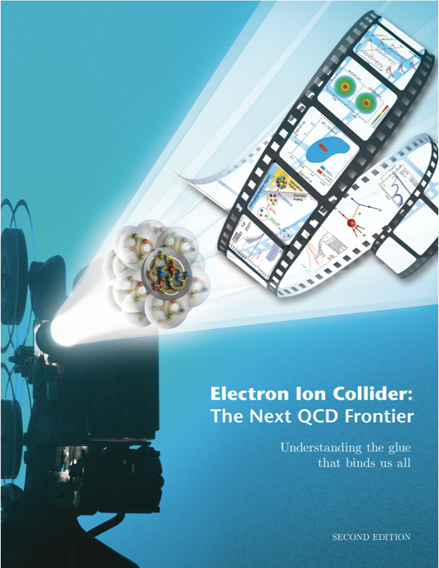
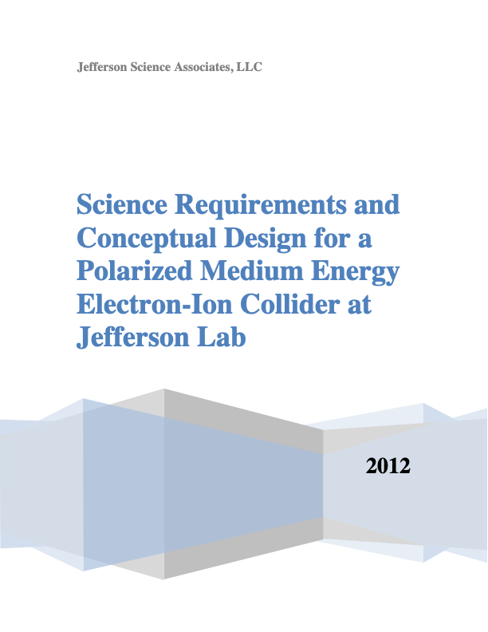
Detector Choices
General Purpose Detector
While relatively well studied, requirements spread over various documents and not always up-to-date. Focus of R&D efforts.
Design/Study efforts dominantly centered at JLAB and BNL
Many open question
1 or 2 detectors; if 2, different emphasis
To fit into funding profile 2nd later?
Specialized Detectors
Discussion has just started
arXiv:1212.1701
arXiv:1409.1633
EIC User Group needs to get involved.
Whatever choice, it has impact on the machine design as well. May be a workshop later this year?
arXiv:1209.0757

Slide 7
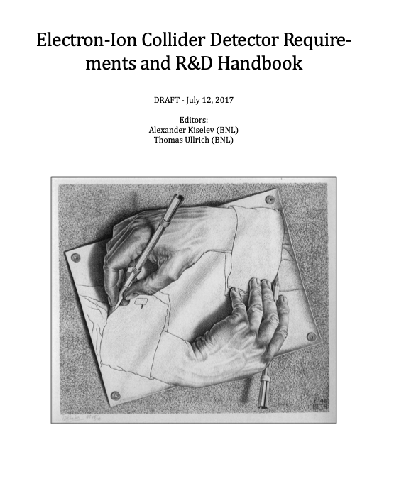
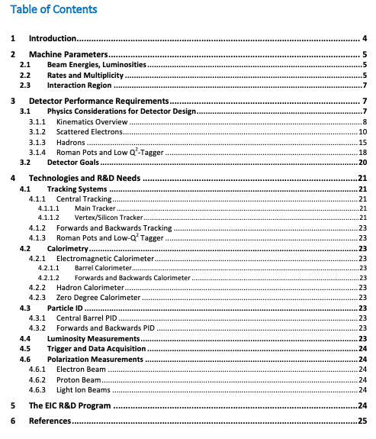
Project: EIC Detector Handbook
“Living” document on requirements, R&D needs, available technologies, EIC kinematics and more
We started with a compilation of information that is available
Update as things become more refined
Right now: not even a draft
Current manpower: TU & A. Kiselev
Volunteers are more than welcome

Slide 8
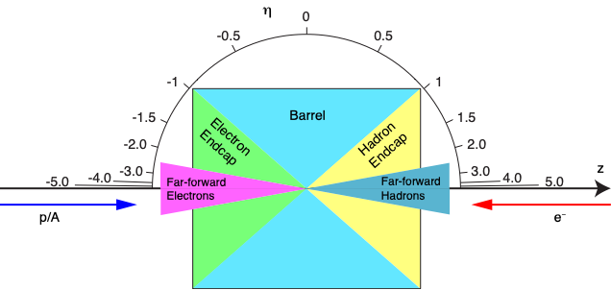
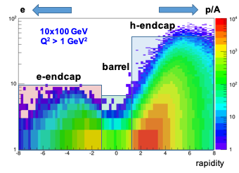
EIC Detector Requirements
Requirement are mostly site-independent with some slight differences in the forward region (IR integration)
From R&D Handbook
In Short:
Hermetic detector, low mass inner tracking, good PID (e and π/K/p) in wide range, calorimetry, forward & backwards tracking
Moderate radiation hardness requirements, low pile-up, low multiplicity
p (GeV/c)

Slide 9
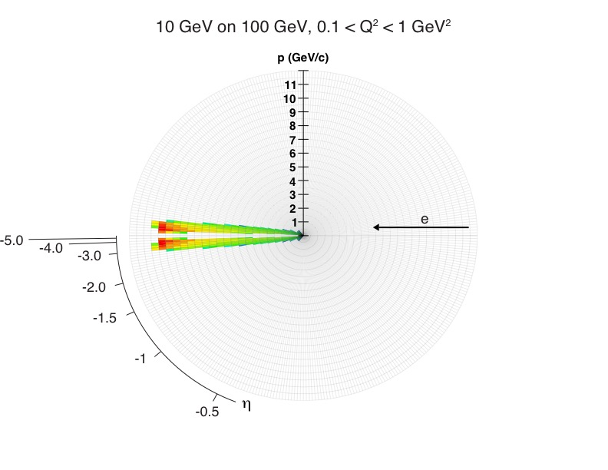
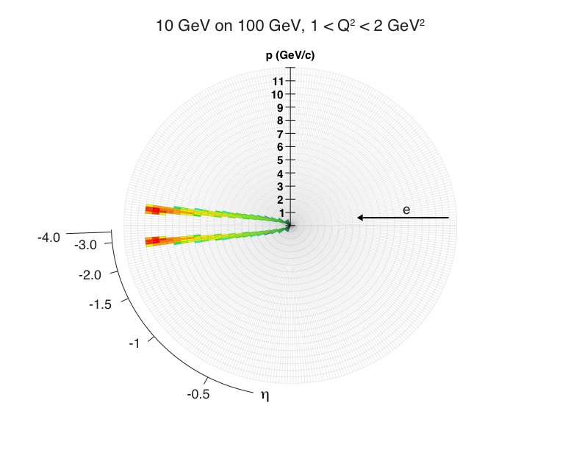
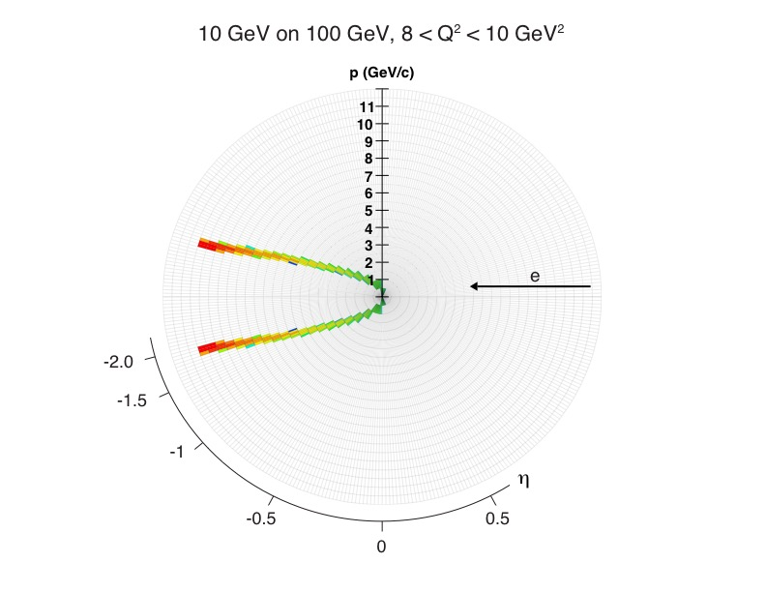
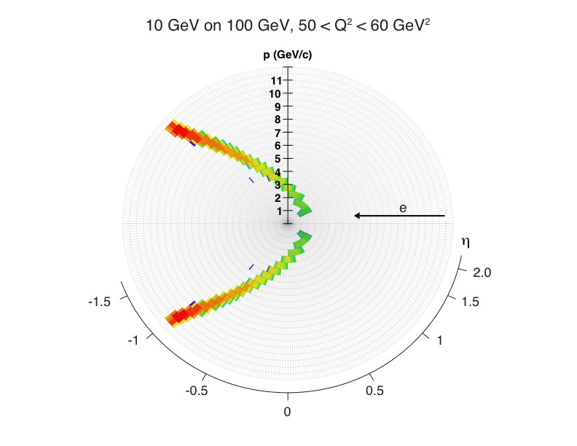
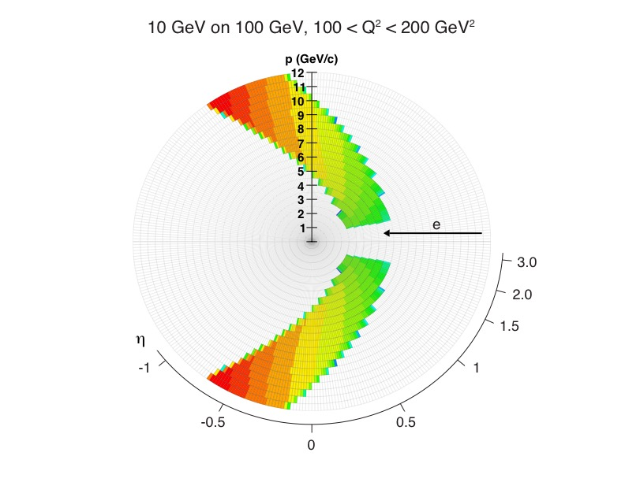
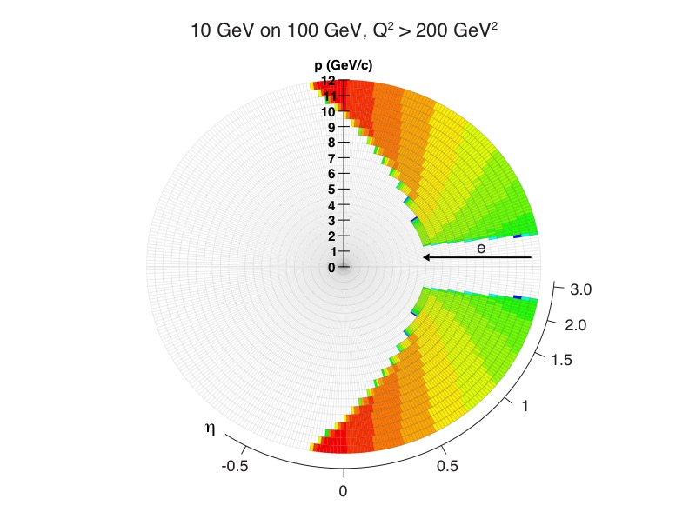
Electron Kinematics
From R&D Handbook
e+p: 10 on 100 GeV

Slide 10
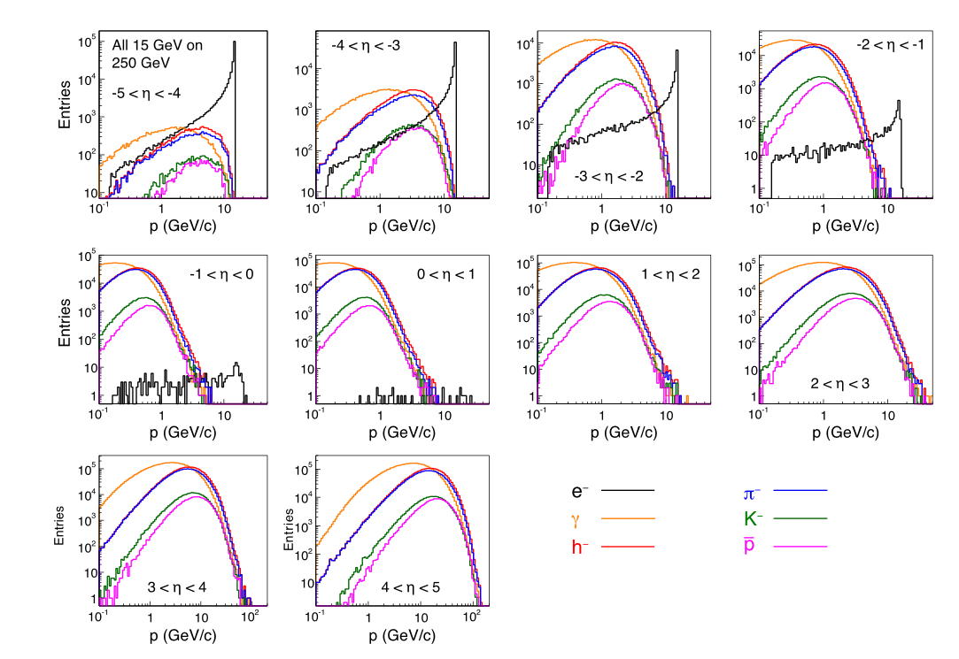
Hadron Kinematics
From R&D Handbook
Here: e+p 15 on 250 GeV
PID is one of the challenges for an EIC detector ⇒ R&D

Slide 11
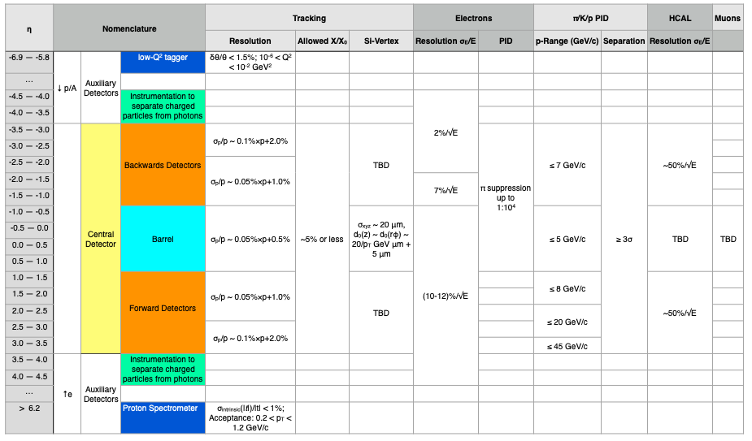
Compilation of EIC Detector Requirements
From R&D Handbook. Requirements as detailed in various documents (EIC WP, eRHIC and JEIC Design Reports).

Slide 12
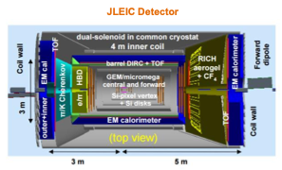
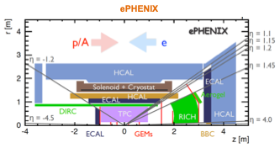
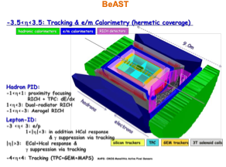
Detector Concepts
Concept Detectors
Important as test bed for detector R&D
Each attempt to match requirements
Nothing is cast in stone
Will evolve as new concepts are developed

Slide 13
eRD1: Calorimetry
Goal: Develop cost effective, flexible techniques to build compact sampling calorimeters that meet the EIC physics requirements.
Efforts:
Tungsten-scintillating fiber EM calorimeter (SPACAL)
Compact calorimeter, developed at UCLA
Investigating high resolution version for e-going endcap
Crystal EMCal
Option for high resolution e-going endcap calorimeter
Shashlik EMCal
Option for h-going endcap calorimeter
HCal
Prototype development in collaboration with STAR forward upgrade and sPHENIX
Readout
SiPM and APDs, radiation studies and support electronics
Participating institutions: BNL, Caltech, CUA, JLAB, IUCF, NPN Orsay, PSU, TAMU, UCLA, USTC, YPI

Slide 14
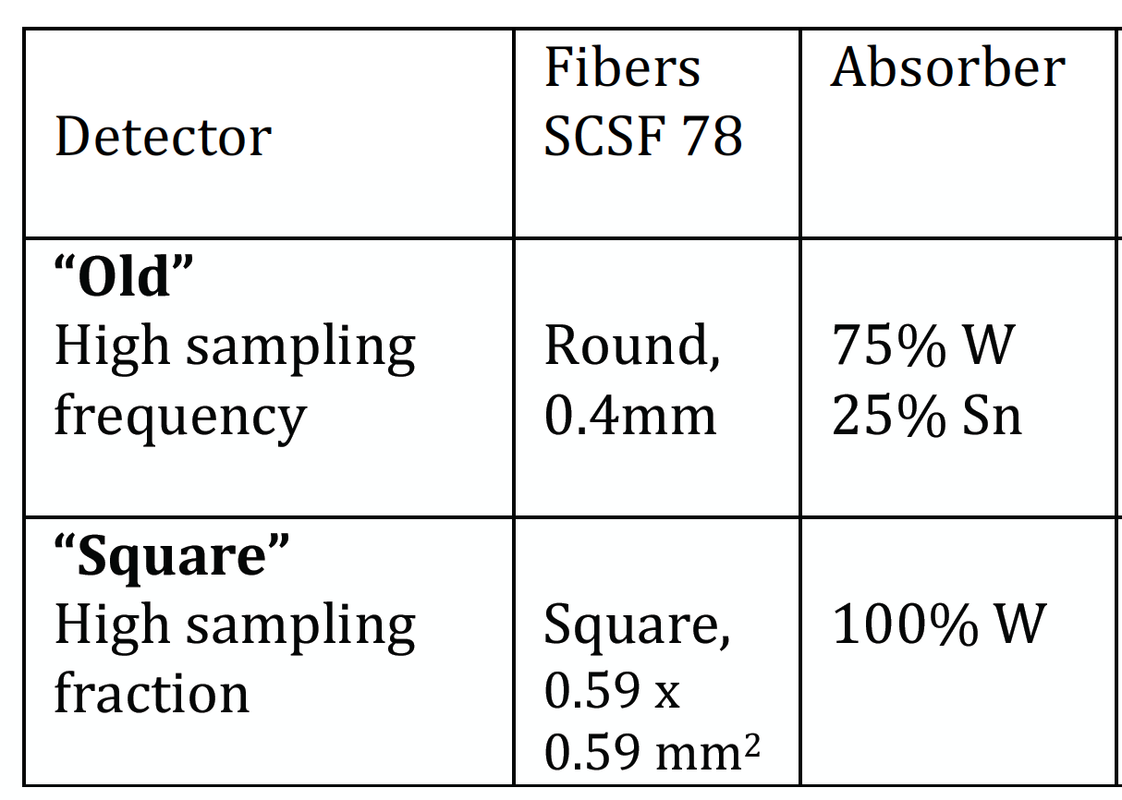
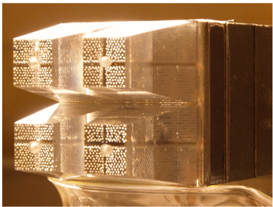
W-SciFi Calorimetry
Scintillating fibers embedded in composite absorber
Round and square fibers tested
Test beam campaigns in 2015 and 2016
Square Fiber version achieves target of 7%/√E, with 1% constant term at 10º, 2.9% at 4º
2017: Optimizing light collection
In RHIC beam in 2017, η=3.75, ~10¹¹ n/cm²)
Issue: SiPM show non-homogeneous degradations, PM by PM. APD?

Slide 15
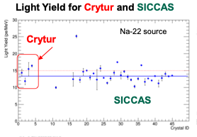
Crystal Calorimetry
See C. Munoz-Camacho , Parallel 1
e-going direction needs high precision calorimetry (~2%/√E)
PbWO calorimeter option for this role, extensively used for high precision calorimetry (CMS, JLab, PANDA…) because of its excellent energy and time resolutions and its radiation hardness
BTCP (Russia) produced high quality crystals in the past but out of business
SICCAS (China) has difficulties maintaining good crystal quality
Collaborative effort with PANDA to qualify CRYTUR (Czech Republic)
Full size (2x2x20 cm³) CRYTUR crystal
2017: chemical analysis ongoing
CUA: growing crystals for faster turnaround time?
Participating institutions: YPI, CUA, IPN-Orsay, JLAB, BNL, Caltech

Slide 16
eRD2: A Magnetic Field Cloaking Device
To retain good momentum resolution in the forward region, need dipole field
Dipole fields affect beam optics
Develop magnetic cloak
Method: Wrapping layers of AMSC high-temperature superconductor around beam pipe
Beam shielding tests with the BNL Van de Graaff accelerator
External dipole
field 30 mT
BNL van de Graaff
See talk by Nils Feege, Parallel 1
Institutions: Stony Brook, BNL, RIKEN

Slide 17
Magnetic Field Cloaking Device
High-field shielding and cloaking tests with MRI magnet at ANL
Shield a 0.5 T field with a 10 cm SC cylinder at liquid nitrogen temperature.
Multi-layer shield
Project has demonstrated magnetic field cloaking with 99% field shielding and 90% reduced field distortions next to the shield at 0.45 T
Magnetic field cloak seems to be a viable option for EIC. Design parameters, fabrication, and limitations understood
Project concluded: arXiv:1707.02361, submitted to NIM

Slide 18
eRD3: MPGD Based Tracking
Development of intermediate tracking system
Barrel tracking system based on Micromegas; curved MM R&D program in close collaboration with Saclay
Forward/Backward tracking system based on triple-GEM
Design and assembly of large cylindrical MM detector elements to demonstrate scaling of technology
Test and characterization of MM chambers with full readout chain based on DREAM chip
MicroMegas (MM):
Participating Institutions:
Temple Univ., Saclay

Slide 19
MPGD Based Tracking
Triple-GEM detector assembly 40x40cm designed
GEM foils from TechEtch and CERN
Close collaboration with industry (TechEtch)
Quality assurance of GEM foils developed based on automatic CCD scanning system
Assembly of triple-GEM chamber with full stacking and cosmic ray test with full readout chain

Slide 20
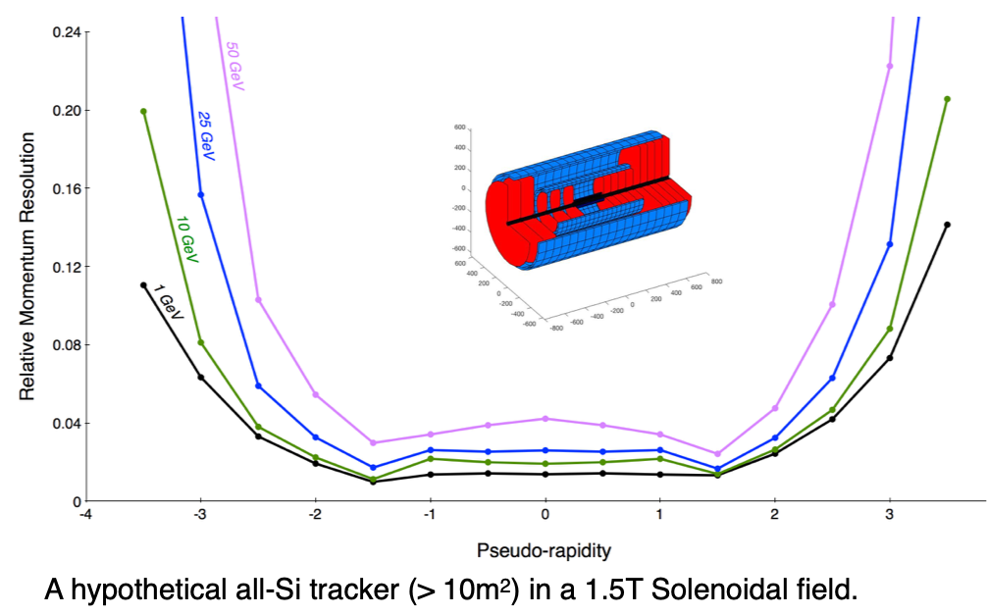
eRD16 & eRD18: Silicon Tracking
Silicon Detector Layout Investigations
Performance requirements: numbers of layers, layout and spatial resolution of the pixel hits
Studies
Using toolset originally developed for ILC: Helix track model, multiple scattering, full track reconstruction from digitized hits using a Kalman filter.
Currently assuming ALPIDE chip
Study includes pileup (integration time)
Institutions: eRD16: LBL, eRD18: Birmingham

Slide 21
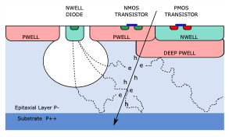
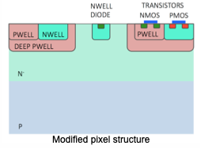
eRD16 & eRD18: Silicon Tracking
Sensor Development
Aim: to demonstrate high spatial resolution in a fully depleted sensor
Advantage of depletion = charge collection by drift ⇒ larger Q, fast collection, small cluster multiplicity
Starting point: ALPIDE sensor (ALICE ITS)
TowerJazz modified process: First results indicate full depletion
Technology strong contender for dedicated EIC MAPS prototype
Exploit on-going ATLAS R&D in Birmingham
Alpide:

Slide 22
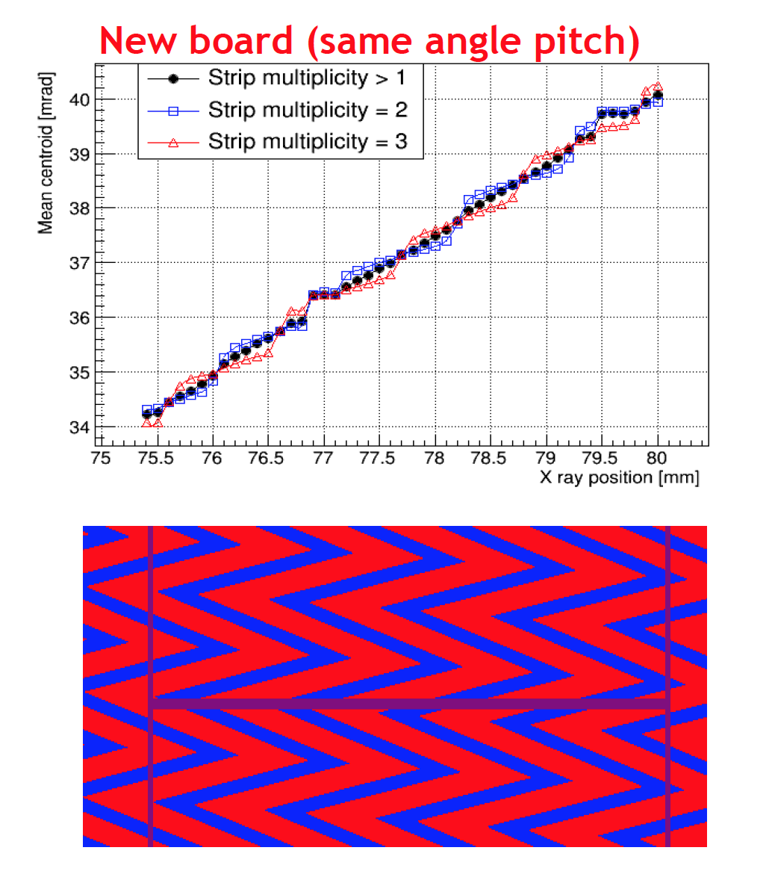
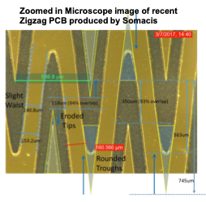
eRD6: ZigZag Strip Readouts
Improve on the position resolution of GEM readout boards with novel design
Implement zig-zag readout; test with 3-GEM readout and X-ray source
Optimization of the zigzag pad readout pattern parameters, fabrication of PCB with this readout pattern and measurement of the relative position resolution in the lab
Recent: Scans of PCBs with improved zigzag strip design achieve < 70 μm spatial resolution
Still suffer from single pad hits in regions near center of pad (due to low gain, non-optimal interleaving, small transverse diffusion, etc)
eRD6: BNL, FIT, INFN Trieste, SBU, UVa, Yale

Slide 23
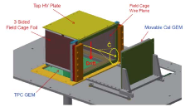
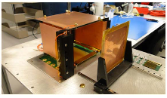
eRD6: Cherenkov TPC
Combines the functions of a TPC for charged particle tracking and a Cherenkov detector for particle identification in same volume
Prototype:
TPC: 10cm drift + 10x10 cm² 4 layer GEM
Cherenkov: 3.3 x 3.3 cm² pad array + 10 x 10 cm² 4 layer GEM
Common Gas: CF4 (vdrift = 7.5 cm/μs & large N0)
Successful demonstration of proof of principle - TPCC works!
Finalizing performance specs on track resolution and Cherenkov light yield, paper in progress

Slide 24
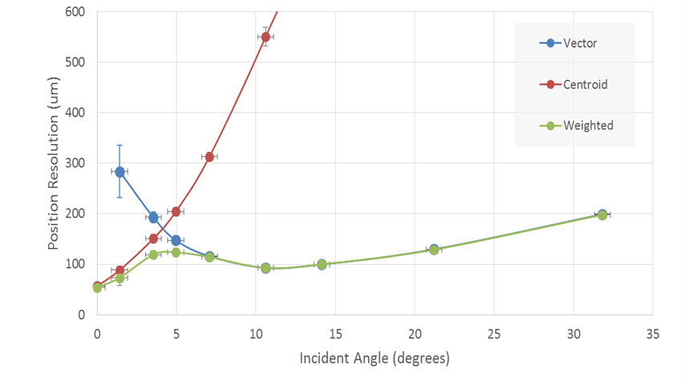
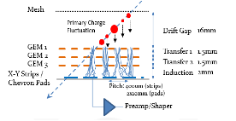
eRD6: Mini-Drift GEM Tracking Detector
Triple GEM stack with a small drift region (mini TPC type configuration)
Position and arrival time of the charge deposited in the drift region were measured on the readout plane allowing reconstruction of track traversing the chamber.
Minidrift overcomes resolution degradation with incident angle for conventional GEM tracking detectors using only charge centroid information.
Compatible with all forms of planar GEM tracker.
Normal Chamber
MiniDrift

Slide 25
eRD6: MPGD-Based Photon Detector for RICHs
Motivation
h-PID in the range 6 < p < 60 GeV/c, a must for EIC
At high momenta: gas radiator is mandatory
Collider detector: short (~ 1 m) radiator length
R&D program
Development of MPGD-based Photon Detectors
Miniaturized pads
Operation in C-F gases
THGEM vs GEM for optimal photoelectron collection
Ion BackFlow (IBF) control
Photocathodes: alternatives to CsI?
CsI: aging, doesn’t tolerate water vapor, O²

Slide 26
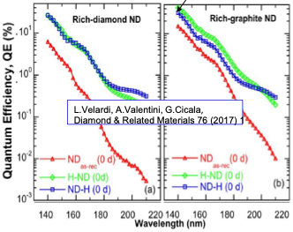
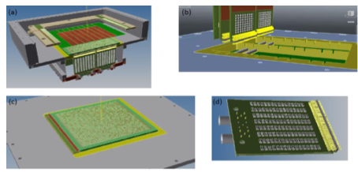
eRD6: MPGD-Based Photon Detector for RICHs
New activity at INFN Trieste
Design of prototype of MM with resistive layer and miniaturized pad-size well advanced
47%
New photocathode
Hydrogenated diamond film: Spray technique making use of NanoCrystals powder at T ~ 120° (instead of std >800° )
Next steps: Coupling of photo converter and MPGDs
see Stefano Levorato , Parallel 1

Slide 27
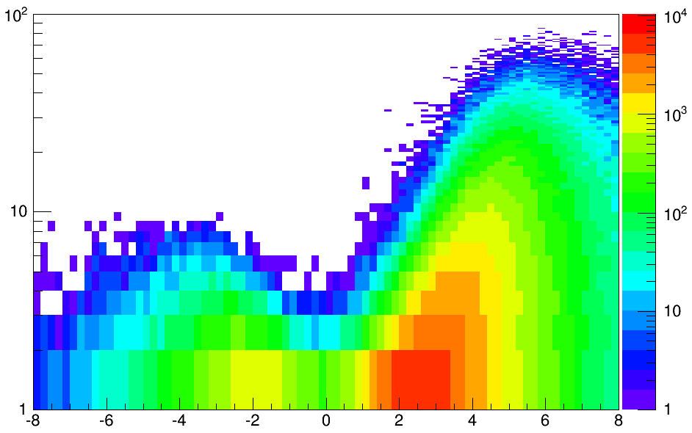
eRD14: PID Consortium
Particle ID is essential for EIC
Developing a suite systems covering the full angular- and momentum range required Imaging Cherenkov detectors are the primary technology
Current Projects
h-side: RICH with two radiators (gas + aerogel) are needed to cover the full momentum range: more than 3 s.d. separation for π/K/p over 3-50 GeV/c
e-side: Compact aerogel RICH covering up to 10 GeV/c (π/K/p) can provide the required PID optimized for EIC physics requirements
Barrel:
DIRC is compact and can cover momenta up to 6-7 GeV/c
ToF issue with determining T0
e
p/A
10x100 GeV
Q² > 1 GeV²
h-endcap
GeV
barrel
e-endcap
Dual-radiator RICH
DIRC
Aerogel RICH
rapidity
Institutes: ACU, ANL, BNL, CUA, William & Mary, Duke, GSU, GSI, Howard, INFN Ferrara, INFN Roma, ISS Rome, JLAB, LANL, ODU, USM, UIC, UNM, SC, Yale

Slide 28
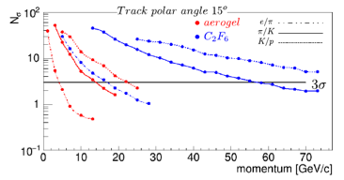
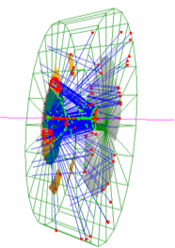
eRD14: dRICH
First dual-radiator RICH developed for use with solenoidal detector
Combination of C₂F₆ gas and n=1.02 aerogel leaves no gaps in coverage
Outward-reflecting mirrors reduce backgrounds and (UV) scattering in aerogel
3D focusing reduces photosensor area
Geant4 sims show excellent performance for hadron and lepton ID
G4 sims include B field
See Alessio Del Dotto, Parallel 1

Slide 29
… and many more
eRD6: Large forward GEM tracker prototype
eRD6: Development of large cylindrical μ-RWELL
eRD6: Chromium GEM foils
eRD12: Electron polarimeter, luminosity monitor and a low Q2-tagger (concluded)
eRD14: Modular aerogel RICH (mRICH) - see Cheuk-Ping Wong, Parallel 1
eRD15: Compton electron detector for polarimetry - see Nicola Minafra, Parallel 1
eRD17: BeAGLE, Tool to refine detector requirements for eA in the saturation regime
eRD19 & New Proposal: Machine background studies
eRD20 - Developing simulation and analysis tools - see Markus Diefenthaler, Parallel 1
and then some …

Slide 30
Take Away Message
The Good
The EIC physics has many characteristics that are unique to the environment and need dedicated R&D.
High quality and highly relevant R&D being carried out within the EIC R&D program.
Good involvement of universities and national laboratories; excellent student involvement, good publication record.
The Bad
The program is at the tipping point. The number of proposals increases steadily while the funding stays flat. We either spread the funding thin (ineffective), or we fund fewer (discourages many, exclude groups we want on board). Neither option is good for the EIC.

Slide 31
Afterthoughts
With the publication of the LRP came a significant increase in international and national participation.
With a (hopefully) positive outcome of the NAS review the number of proposals and groups will certainly go up further.
Many of the participating groups will be an important part in the formation of EIC collaborations and will likely be those that form detector groups.
We suggested to DOE an increase towards a $3-4M/year level within 3-4 years if possible. International support will help, but the US has to take the lead (increased R&D funding was recommendation in LRP ’15)
Strengthening the R&D program would ensure that the technologies exists and are mature enough to carry out the EIC physics program.

