Slide 1
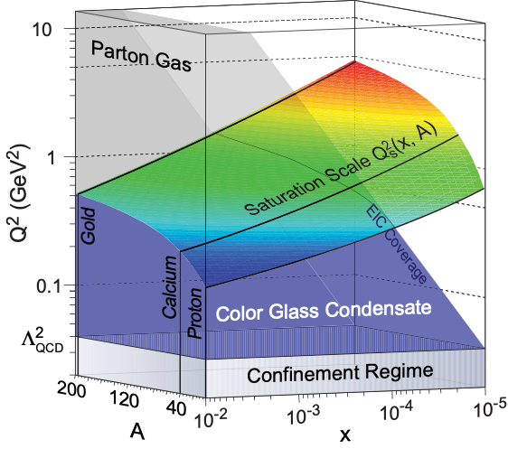
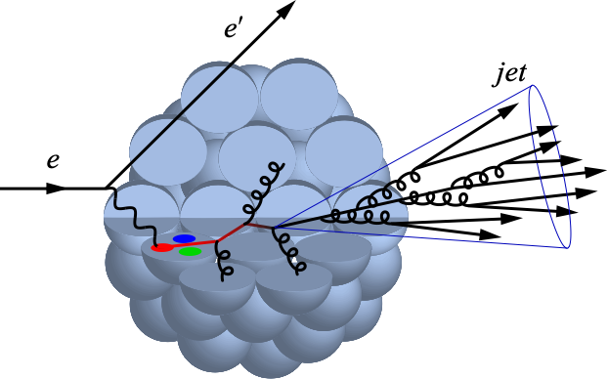
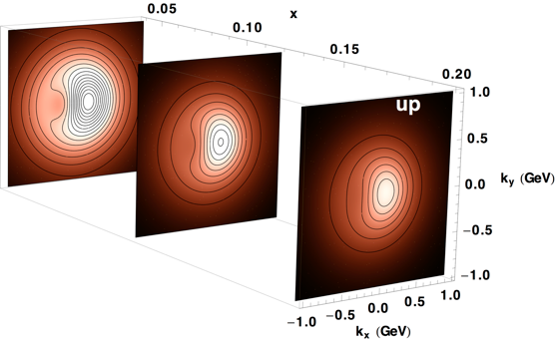
Electron-Ion Collider: Goals
Investigate with precision universal dynamics of gluons
Central themes:
Probing the momentum-dependence of gluon densities and the onset of saturation in nucleons and nuclei
Mapping the transverse spatial and spin distributions (imaging) of partons in the gluon-dominated regime
Provide novel insight into propagation, attenuation and hadronization of colored probes

Slide 2
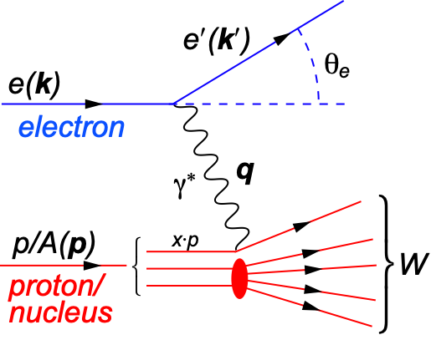
Deep Inelastic Scattering (DIS)
DIS:
As a probe, electron beams provide unmatched precision of the electromagnetic interaction
Direct, model independent, determination of kinematics of physics processes
x:
y:
s:
Q²:
square of center-of-mass energy of electron-hadron system
Bjorken-x
x is fraction of the nucleon’s momentum carried by the struck quark
0 < x < 1
squared momentum transfer from scattered electron
Virtuality
“Resolution” power
Inelasticity
Fraction of electron’s energy lost in nucleon restframe
0 < y < 1
y = const
Energy s
log Q²
log x
1
s: center-of-mass energy squared
Q²: resolution power
x: momentum fraction of parton
y: inelasticity
quark+anti-quark
momentum distributions
gluon momentum distribution
Notes:
W2 can also be interpreted as the center-of-mass energy of the gauge boson nucleon system.
Q2 max = s
Q2: negative square of the momentum transfer q, denotes virtuality
x: make Remark that for e+p 0 < x < 1 while for e+A scattering 0 < x < A.
y: is the fraction of the lepton’s energy lost in the nucleon rest frame. It it thus also the fraction of the incoming electron energy (also known as inelasticity) carried by the exchange boson (photon) in the rest frame of the nucleon
Q^2 &=& -q^2 = - (k-k^\prime)^2 \\
&\approx& 4 E E^\prime \sin^2\left(\frac{\theta}{2}\right)

Slide 3
EIC Science: Requirements
Large center-of-mass coverage
Access to wide range in x and Q²
Polarized electron and hadron beams
Access to spin structure of nucleons and nuclei
Access to 3D spatial and momentum structure of nucleon
Nuclear beams
Accessing the highest gluon densities (QS² ~ A^{⅓})
High luminosity
Essential for mapping 3D structure of nucleons and nuclei access to rare probes
⇒ Unique QCD machine:
The world’s first polarized electron-polarized proton collider
The world’s first electron-heavy ion collider
Luminosities: a hundred to up to a thousand times HERA

Slide 4
Documenting the Physics Case
White Paper documents the physics
case of an EIC
(Eur.Phys.J. A52 (2016), 268; arXiv:1212.1701)
In terms of requirement it says:
Highly polarized (70%) e⁻ and p beams
Ion beams from D to U
Variable center-of-mass energies from 20-~100 GeV
upgradable to 140 GeV
High collision luminosity 10³³⁻³⁴ cm⁻²s⁻¹
Possibilities of having more than one interaction region
Almost all studies in the WP were conducted at √s=140 GeV for p beams and √s=90 GeV for Au/Pb beams with ∫Ldt = 10 fb⁻¹/A

Slide 5
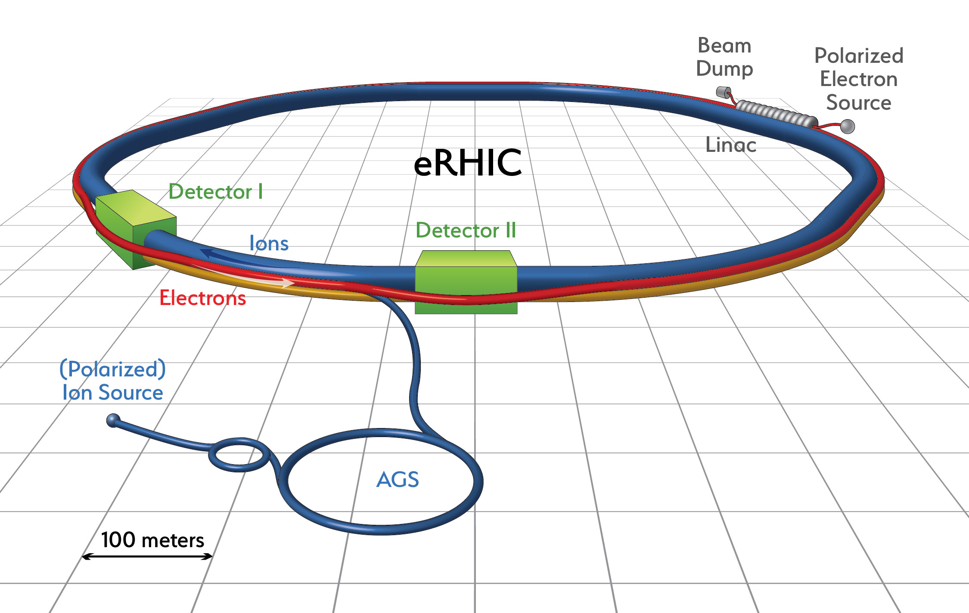
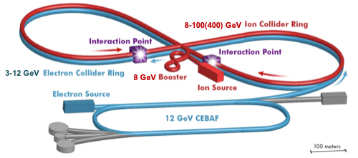
US Electron Collider: Realization
eRHIC (BNL)
Add e Rings to RHIC facility: Ring-Ring (alt. recirculating Linac-Ring)
Electrons up to 18 GeV
Protons up to 275 GeV
√s=30-140 √(Z/A) GeV
L ≈ 1×10³⁴ cm⁻²s⁻¹ at √s=105 GeV
JLEIC (JLab)
Figure-8 Ring-Ring Collider, use of CEBAF as injector
Electrons 3-10 GeV
Protons 20-100 GeV
e+A up to √s=40 GeV/u
e+p up to √s= 64 GeV
L ≈ 2×10³⁴ cm⁻² s⁻¹ at √s=45 GeV
In the WP the quoted energy requirements were driven by what was considered feasible (mostly cost) rather than physics arguments
Is √s=90/140 GeV enough?
Would 40/64 GeV already do the job?
What would one miss?
This is not a question of which facility but of defining requirement for the machine designer.
eRHIC: arXiv:1409.1633, JLEIC: arXiv:1504.07961
Notes:
The designed frequency matching scheme allows operation with hadron energies down to 40 GeV/u, but the energies between 46 and 98 GeV/u cannot be used.

Slide 6
arXiv:1708.01527
E.C. Aschenauer (BNL), S. Fazio (BNL), J.H. Lee (BNL), H. Mantysaari (Jyväskylä), B. S. Page (BNL), B. Schenke (BNL), TU (BNL), R. Venugopalan (BNL), P. Zurita (BNL)
and the help/input of:
M. Diehl (DESY), A. Dumitru (Baruch), A. Kiselev (BNL), H. Paukkunen (Jyvaskyla), R. Sassot (Buenos Aires), V. Skokov (RBRC/BNL), M. Stratmann (Tubingen), L. Zheng (CCNU).
Thomas Ullrich (BNL/Yale)
HIT Seminar
LBL, May 29, 2018

Slide 7
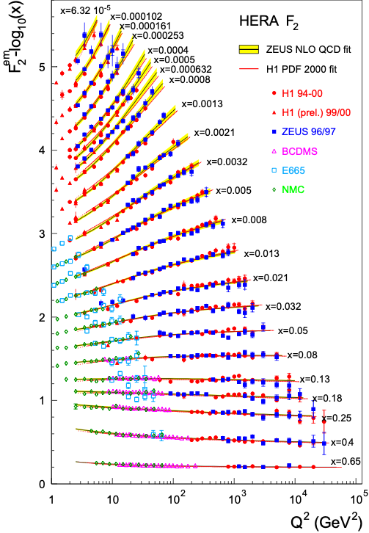
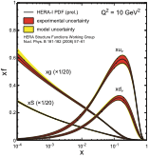
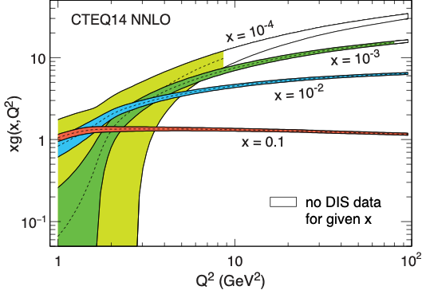
Lessons from DIS Experiments (I)
Parton distribution functions (PDFs) generated using pQCD+DGLAP evolution equations (along Q²)
Quarks: qi(x,Q²) from F2 (or reduced cross-section)
Gluons: g(x,Q²) through scaling violation: dF²/dlnQ²
Large uncertainties at x=10⁻³ and 10⁻⁴ at the small Q² although high quality data exist.
The precision of low Q² data is ineffectual due to the lack of data at the larger Q² (Evolution from low to high Q²)
Lesson: Large Q² lever arm is key
QCD
Notes:
In LO: Probability to find parton with x, Q2 in proton
DGLAP (RGE)

Slide 8
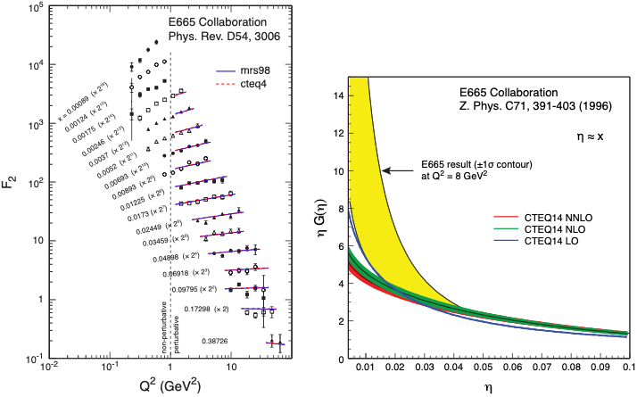
Lessons from DIS Experiments (II)
Fixed target E665: ep at √s = 31 GeV
Things go terrible wrong at low energies (here e+p)
Lesson: The small x and large Q² region governs the precision with which gluon distributions can be extracted from scaling violations (same for e+A)

Slide 9
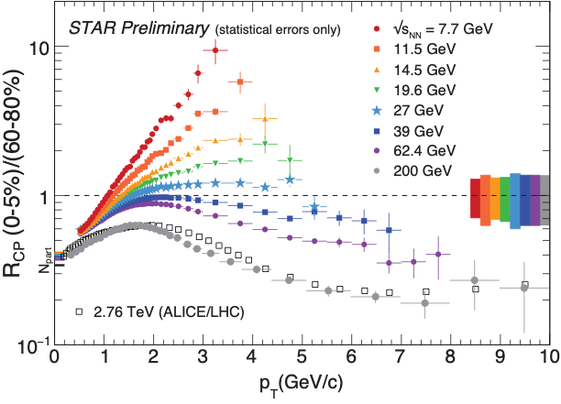
Lessons from Heavy-Ion Collisions
Charged hadron suppression, expressed by RCP, measured at RHIC energies, √sNN = 11.5 - 200 GeV and at the LHC at √sNN = 2.76 TeV.
Recall Pb+Pb program at SPS with √sNN = 17.2 GeV
Lesson from RHIC: need a significant √s range and reach well beyond those of prior fixed target DIS (e/μ/ν+A) machines.
In DIS the kinematic equivalent of √s in heavy-ion collisions is the range in x for fixed Q² (Q² ~ x∙s)
EIC at max(min) energy range: For e+A at fixed Q², range in x is a factor of > 20(4) greater than available at fixed-target machines
Notes:
The success of RHIC suggests that the discovery
potential of a high energy EIC is high and that
energy reach and range plays a pivotal role.

Slide 10
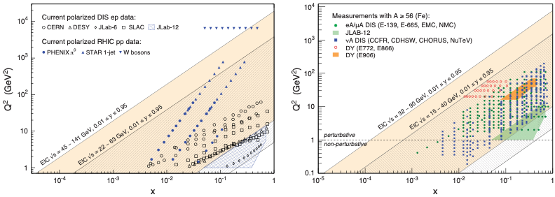
EIC versus Fixed Target: Kinematic Range
EIC cannot compete with e+p at HERA (√s = 318 GeV)
EIC’s strength is polarized e↑+p↑ and e+A collisions
Here the kinematic reach extends substantially compared to past (fixed target) coverage
x/20 for e+A (x/4 for lower energy range)
x/100 for polarized e↑+p↑ (x/20 for lower energy range)

Slide 11
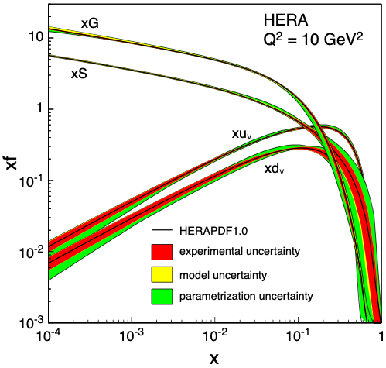
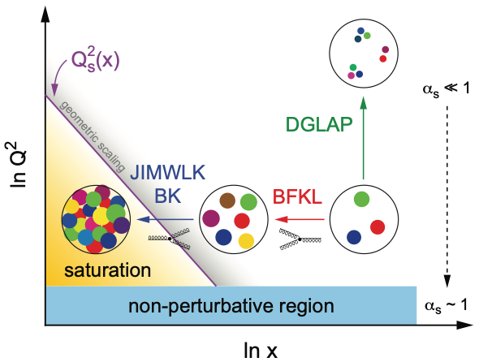
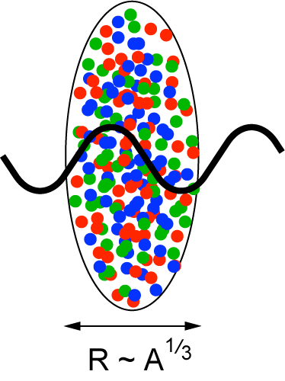
e+A at EIC: Saturation Physics
Gluon Saturation
Can we find evidence of non-linear QCD dynamics?
What is the dynamics of gluon saturation? How does it evolve?
Is the Color Glass Condensate the correct theory in this realm?
Enhancement of QS with A: saturation regime reached at significantly lower energy in nuclei (and lower cost)

Slide 12
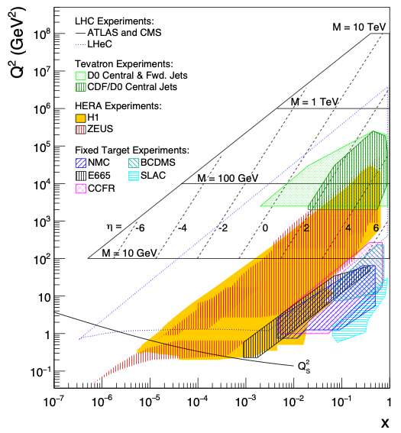
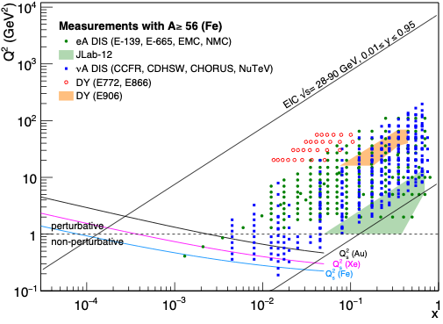
Gluon Saturation: Past Experimental Reach
HERA (ep)
Marginal reach of Qs
Only at low Q² making comparison with perturbative QCD impossible
Fixed Target DIS Experiment
eA, μA, νA
Same marginal reach
Only at low Q² (Q² < 1 GeV²)

Slide 13
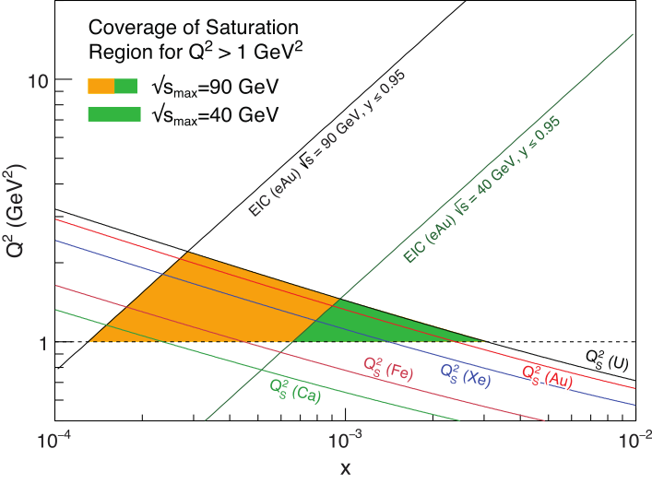
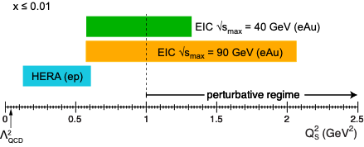
Gluon Saturation: √s Matters
eA at EIC:
Need to push into regime where comparison with our current understanding can be made ⇒ Q² > 1 GeV/c²
Require lever arm in Q, x to study evolution
CGC predicts very characteristic A dependence ⇒ need large A lever arm
Need to push for highest energy and heaviest ions

Slide 14
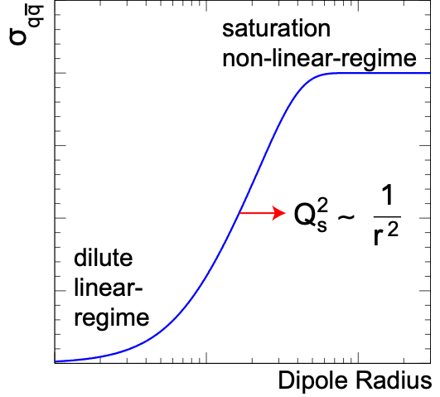
N.B.: Important Dual Description of DIS
Dipole Cross-Section:
sat
non-sat
Bjorken frame: Partonic picture of a hadron is manifest. Saturation shows up as a limit on the occupation number of quarks and gluons.
Dipole frame: Partonic picture is no longer manifest. Saturation appears as the unitarity limit (black disk) for scattering. Convenient to resum the multiple gluon interactions.
Dipole frame commonly used to describe diffractive processes
[A. Mueller, 01; Parton Saturation-An Overview]

Slide 15
Examples of Energy Impact on Key Measurements at an EIC

Slide 16
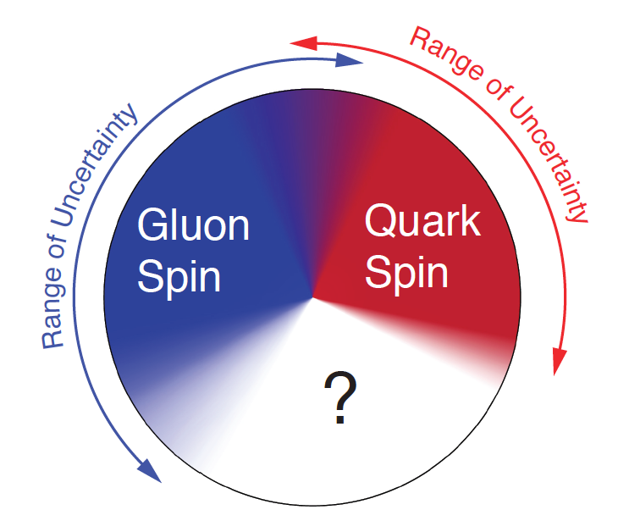
Key Topic in ep: Proton Spin Puzzle
What are the appropriate degrees of freedom in QCD that would explain “spin” of a proton?
After 20 years effort
Quarks (valence and sea): ~30% of proton spin in limited range
Gluons (latest RHIC data): ~20% of proton spin in limited range
Where is the rest?
It is more than the number ½! It is the interplay between the intrinsic properties and interactions of quarks and gluons
Jaffe-Manohar sum rule:
Notes:
\frac{1}{2} = \frac{1}{2}\int_0^1 \mathrm{d}x \Delta\Sigma(x, Q^2) + \int_0^1 \mathrm{d}x \Delta g(x, Q^2) + \sum_q{L_q + L_g}

Slide 17
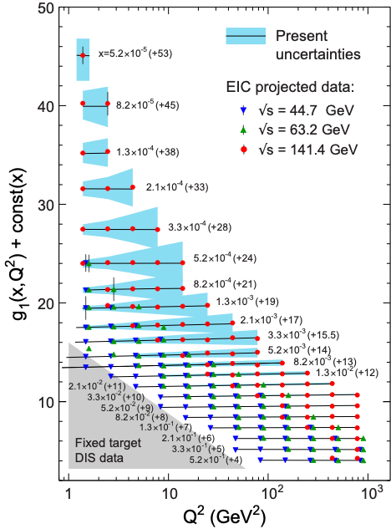
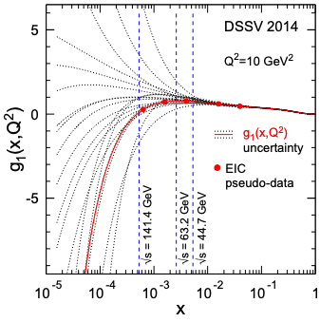
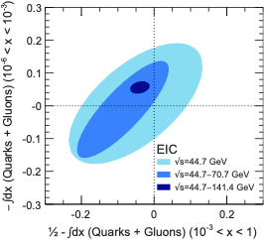
EIC: Measuring Spin of Proton
Determine the contribution of quarks and gluons to the proton spin need to measure g1 as function of x and Q²:
Why has energy reach such a dramatic impact?

Slide 18
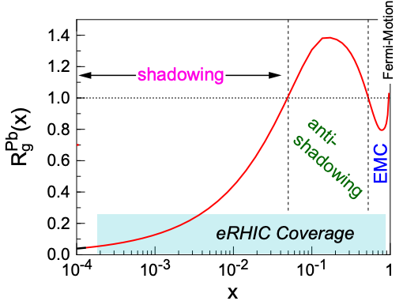
EIC: Nuclear Structure Functions
Inclusive DIS on eA:
quark+anti-quark
gluon
F2 and FL are benchmark measurements:
Theory/models have to be able to describe the structure
functions and their evolution.
Leading twist pQCD models parameterize the observed suppression of the structure function with decreasing x using nuclear parton distribution functions (nPDFs)
Aim at extending our knowledge on structure functions into the realm where gluon saturation effects emerge
Notes:
\frac{d^2 \sigma^{eA\rightarrow eX}}{dx dQ^2} = \frac{4 \pi \alpha^2}{x Q^4} \left[ \left(1-y+\frac{y^2}{2}\right) {\color{blue}F_2(x, Q^2)} - \frac{y^2}{2} {\color{red}F_L(x, Q^2)}\right]

Slide 19
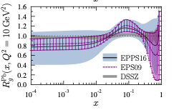
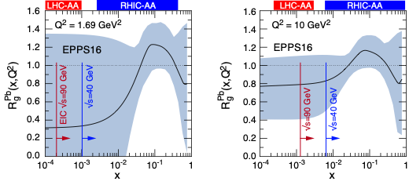
Nuclear PDFs
nPDFs less well known due to lack of data
Matters for Heavy-Ions Physics
Theory/models have to be able to describe the structure functions and their evolution
DGLAP:
predicts Q² but not A and x dependence
Saturation models (JIMWLK):
predict A and x dependence but not Q²
Need: large Q² lever-arm for fixed x, A-scan
nPDF fits typically performed on reduced cross-section
e+A: Aim at extending our knowledge on structure functions into the realm where gluon saturation (higher twist) effects emerge
⇒ different evolution (JIMWLK)

Slide 20
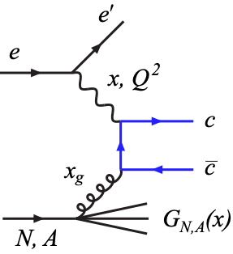
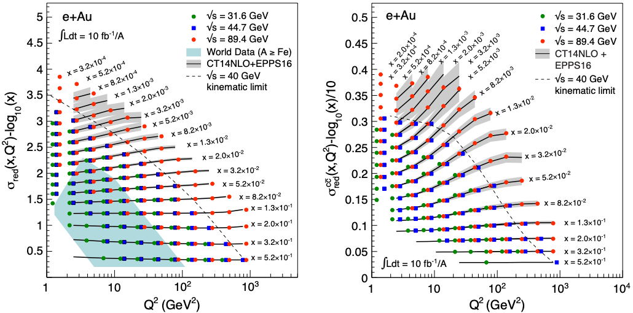
EIC: Structure Functions in eA
EIC pseudo-data
FL, F2, σred, F2^{cc} values from EPPS16
Errors (sys and stat.) from simulations for ∫Ldt=10 fb⁻¹/A
arXiv:1708.01527, 1708.05654

Slide 21
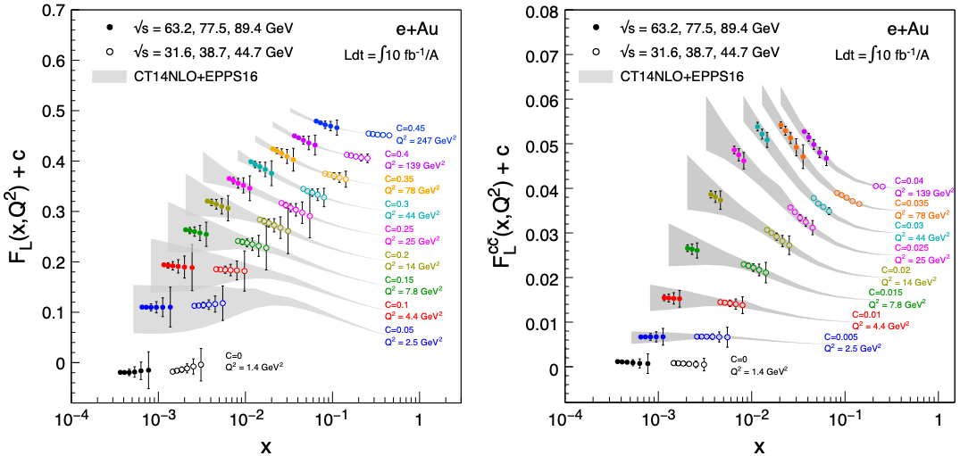
EIC: FL Structure Function
FL probes glue more directly
FL is small and requires running at different √s and thus has larger systemic uncertainties than F2
Dramatic improvements with EIC at highest energy

Slide 22
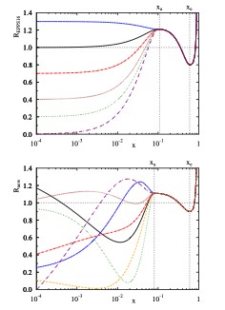
The Problem of Estimating nPDF Constraints
Methods:
Use σred (includes F2 and FL (F3)) pseudo data
Re-weighting EPPS16
EPPS16 is a bit stiff at low-x, over-constraints at low-x
EPPS16* (arXiv:1708.05654, Hannu Paukkunen)
more flexible form cures EPPS16 problem (low-x bias)
might underestimate impact?
EPPS16
EPPS16*
Notes:
Inclusive DIS cross-section, simplified (reduced) by dividing out the Mott cross-section.

Slide 23
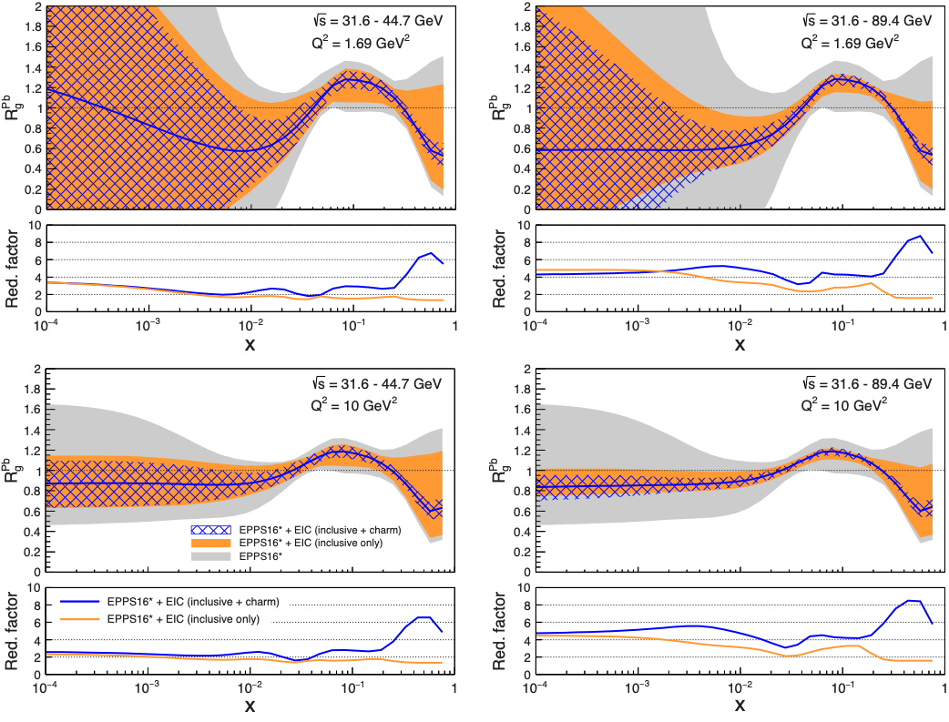
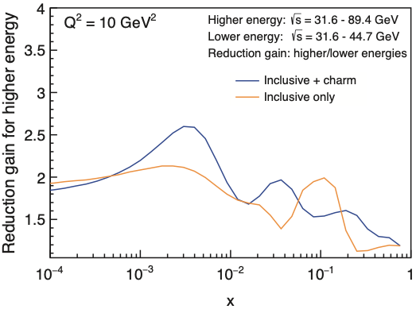
EIC’s Impact on nPDFs (Rglue)
Improves uncertainties substantially out to 10⁻⁴
Shrinks uncertainty band by factors 4-8 for higher energy range 2-6 for lower range
Charm: no additional constraint at low-x but dramatic impact at large-x
Highest EIC √s is key for low-x reach
Q² ~ 1.7 GeV²
Q² ~ 10 GeV²
arXiv:1708.01527

Slide 24
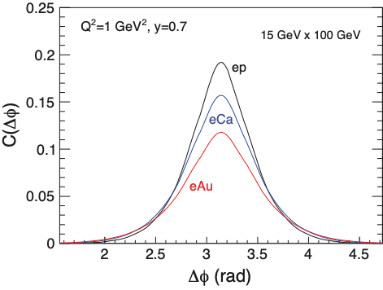
Dihadron Correlations
Forward dihadron correlation in Dilute-Dense factorizations as a probe to saturation.
Experimental Simple Measurement
beam-view
pT^{trigger}
suppression
increasing with A
pT^{assoc}
p
Already tantalizing hints from p+A
studies at RHIC (STAR & PHENIX)
Predicted [C. Marquet, 09] as important hint of saturation
Interpretation: decorrelation due to interaction with low-x gluonic matter
Robust calculations available (Albacete, Dominguez, Lappi, Marquet, Stasto, Xiao) including Sudakov resummation in dijet processes

Slide 25
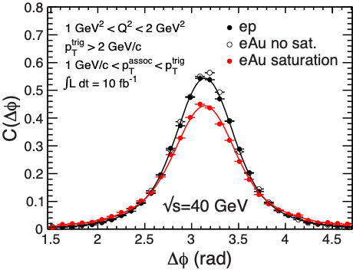
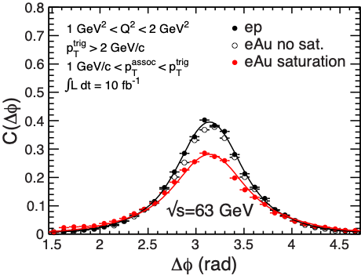
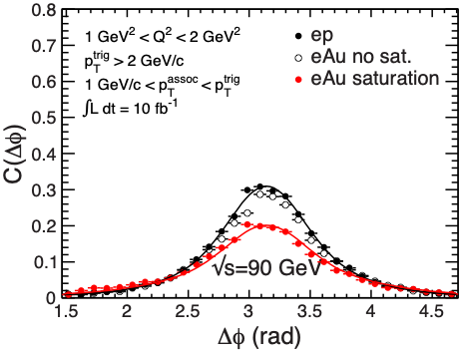
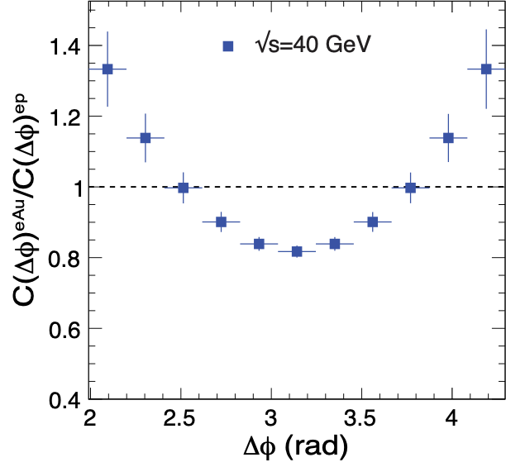
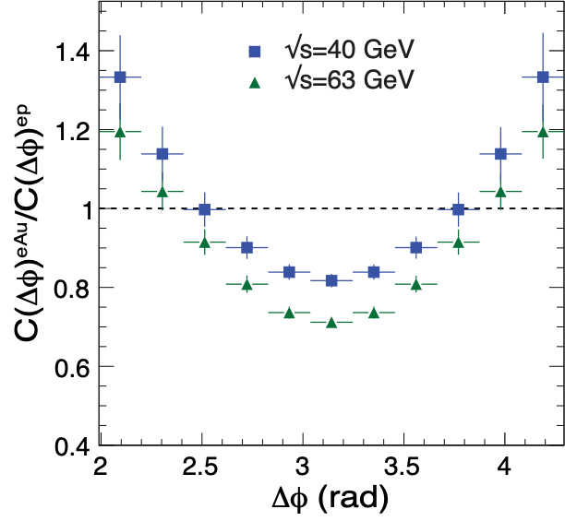
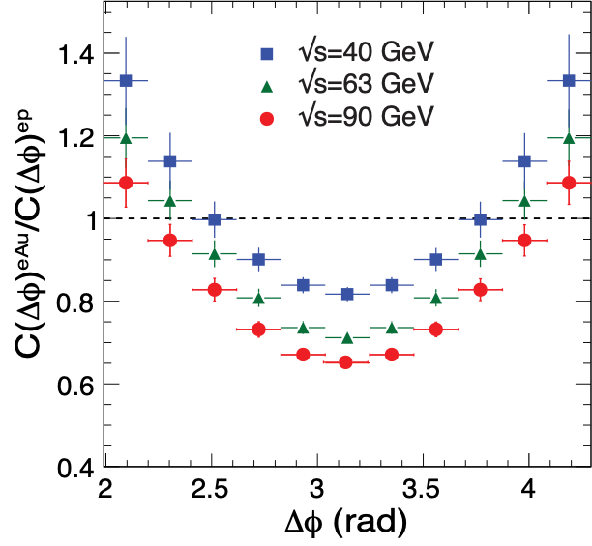
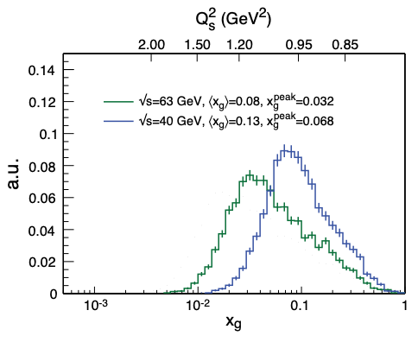
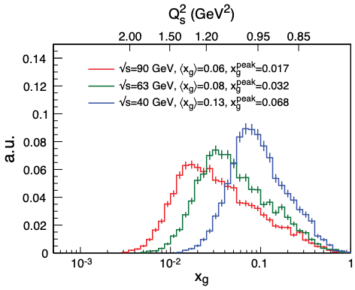
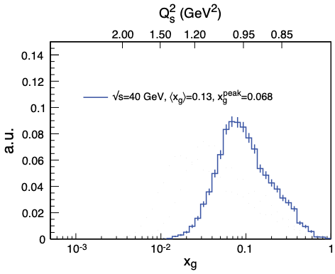
EIC Simulation Results: Dihadrons
Ratio
Zheng et al., PRD89 (2014) 074037;
BNL-114111-2017, arXiv:1708.01527
Model
Uncertainties
Clear saturation signature
Substantial suppression
Similar Dijet Correlations
Unique measurement of WW Gluon Distributions (nTMDs)
Requires large EIC √s so effect not dominated by model uncertainties

Slide 26
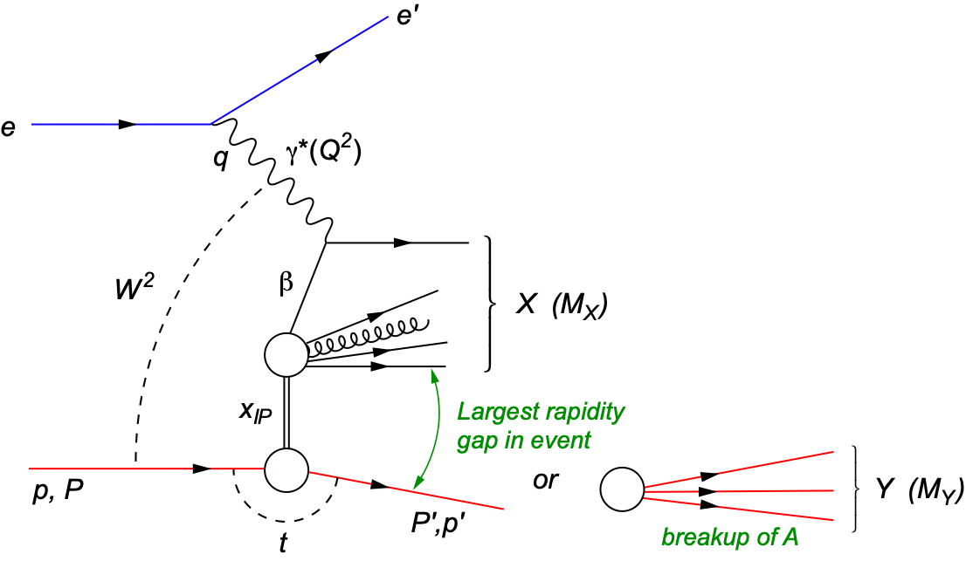
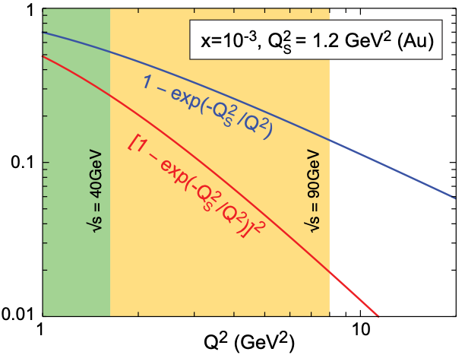
Diffraction for the 21st Century
Diffraction is most precise probe of non-linear dynamics in QCD
Will be major component of any e+A program
HERA: σdiff/σtot ~ 14%
High sensitivity to gluon density: σ~[g(x,Q²)]² due to color-neutral exchange (e.g. in exc. VM prod.)
Only known process in e+A where spatial gluon distributions can be extracted (relevant for HI)
Dipole Cross-section:
DIS versus Diffraction
DIS
Diffraction
t: momentum transfer
squared
MX: mass of diffractive final-state
coherent
incoherent
p/A stays intact
p/A breaks up

Slide 27
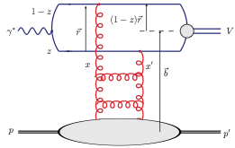
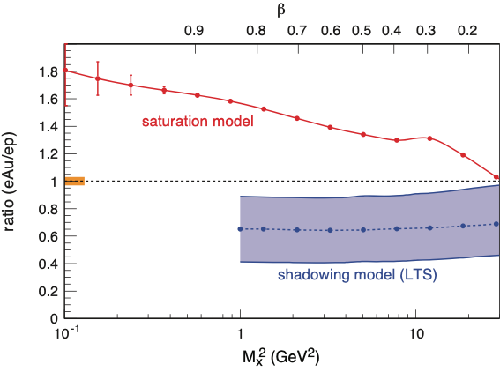
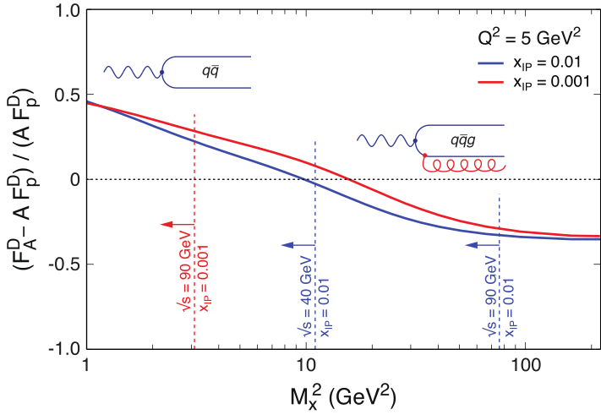
Key Measurement: σdiffractive/σtotal
HERA observed: ~14% of all events are diffractive
Saturation models (CGC) predict up to σdiff/σtot ~ 25% in eA
Ratio enhanced for small MX and suppressed for large MX
Standard QCD predicts no MX dependence and a moderate suppression due to shadowing.
Sign Change:
Eur.Phys.J. A52 (2016), 268
β: fraction of the momentum of the pomeron that is carried by the struck quark within the proton or nucleus
arXiv:1708.01527
Observing these M_{x} dependencies
over wide range in x and Q² is crucial!
Unambiguous signature for reaching the saturation limit
Notes:
Dipole cross-section is closer to the unitarity limit than the proton - it is “blacker”. The elastic scattering probability of a qq̅ dipole is maximal in the “black” limit
The qq̅g component is suppressed for nuclei compared to the proton.
This is due to the fact that in a nucleus the scattering amplitude
is closer to the unitarity limit when the qq̅g component vanishes
different b -dependences from each other and from the inclusive
cross section. The q ¯q -component is enhanced at small b (closer to the black disk limit),
whereas the q ¯qg -part is dominated by larger b (because it vanishes in the black disk limit).
Depending on the mass of the diffractive system MX
or, equivalently, , the diffractive structure function is
dominated by either the q ¯q or q ¯qg Fock states.
invariant mass of the diffractive system is large, and
this large phase space is filled by radiation of additional
gluons, each of them being suppressed by
alpha_s .
The q ¯q -components of
the FD
2A are enhanced compared to A times the proton
diffractive structure functions. This is to be expected,
because of the fact that in a gold nucleus the dipole cross
section is, on average over the transverse area, closer to
the unitarity limit than the proton - it is “blacker”. The
elastic scattering probability of a q ¯q dipole is maximal in
the “black” limit and the approach to it is quicker in a
large nucleus. The q ¯qg component, on the other hand,
is suppressed for nuclei compared to the proton. This is
due to the fact that in a nucleus the scattering amplitude
is closer to the unitarity limit when the q ¯qg component
vanishes, as can be seen e.g. from Eq. (13). This
leads to a nuclear suppression of the diffractive structure
function in the small region, where the q ¯qg component
dominates. The net result of the different contributions
is that FD
2A , for a large range in , is close to AFD
2p .

Slide 28
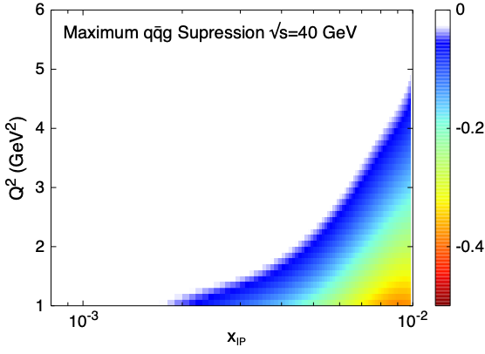
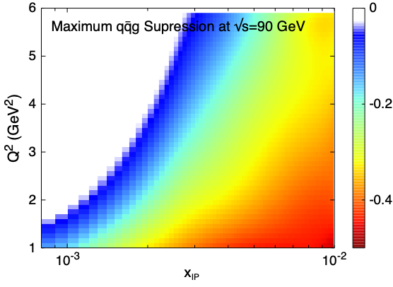
Diffractive Structure Functions - Sign Flip
Where can I see the sign-change?
For given xIP, Q² plot value of lowest ratio < 0 in kinematical allowed region
Only the higher energy range has sufficient phase space in x and Q² to map out the effect of saturation on inclusive diffractive events
Notes:
I did something like what we discussed: I plot inclusive diffractive structure function ratio such that we see the sign change (qqg suppression at large Mx means negative result).
Then, I do as follows: at each x,Q^2, go to the largest possible Mx^2 allowed by sqrt(s). Then see what is this ratio. Then I plot this ratio in x,Q^2 plane in the region where it is negative. So basically white means that we have no access into this region, and more “hot” the color is, more deep we are within this region.
The heatmap shows some artifacts of the smoothening as I had quite spare grid, but this can be improved. But let me know if this is useful. It might be “too complicated to explain quickly”

Slide 29
EIC: Gluon TMDs from Dijet Production
Thus far, focus on quark TMDs while the available studies of gluon TMDs are sparse
Of particular interest: WW gluon distribution G⁽¹⁾ and its linearly polarized partner hT⁽¹⁾ inside unpolarized hadron
These gluon distributions play also central role in small-x saturation phenomena.
G⁽¹⁾ and hT⁽¹⁾ can be accessed through measuring azimuthal anisotropies in processes such as jet pair (dijet) production in e+p and e+A scattering.
A. Metz and J. Zhou, Phys. Rev. D84 , 051503 (2011), arXiv:1105.1991.
D. Boer, P. J. Mulders, and C. Pisano, Phys. Rev. D80 , 094017 (2009), arXiv:0909.4652
D. Boer, S. J. Brodsky, P. J. Mulders, and C. Pisano, Phys. Rev. Lett. 106 , 132001 (2011), arXiv:1011.4225.
F. Dominguez, J.-W. Qiu, B.-W. Xiao, and F. Yuan, Phys. Rev. D85 , 045003 (2012), arXiv:1109.6293.
A. Dumitru, L. McLerran, and V. Skokov, Phys. Lett. B743 , 134 (2015), arXiv:1410.4844.
A. Dumitru and V. Skokov, Phys. Rev. D91 , 074006 (2015), arXiv:1411.6630.
A. Dumitru, T. Lappi, and V. Skokov, Phys. Rev. Lett. 115 , 252301 (2015), arXiv:1508.04438.
A. Dumitru and V. Skokov, Phys. Rev. D94 , 014030 (2016), arXiv:1605.02739.
Notes:
(WW) gluon distribution (G(1)) + linearly polarized partner (h(1))

Slide 30
Kinematics: Dijets in γ*A
Key observables: PT and qT
the difference in momenta (imbalance)
the average transverse momentum of the jets
φ is angle between PT and qT
work in “correlation limit” PT >> qT
azimuthal asymmetry arising from the linearly polarized gluon distribution: v2 = ⟨cos 2φ⟩
Dominguez, Marquet, Xiao, Yuan, PRD 2011
Notes:
Dijet production in e+A at high energies originates from long-ranged eikonal interactions ⇒ parameterizing the azimuthal structure arising from the linearly polarized gluon distribution also in terms of v2
“Correlation limit” PT >> qT involves only 2-point functions / TMDs
z: lightcone momentum fractions

Slide 31
Elliptic Anisotropy in DiJet Production (I)
Dipartons from McDijet event generator (V. Skokov) → showers via Pythia → experimental cuts → jet-finding with ee-kt (FastJet)
All polarizations
Trans. γ*
Long. γ*
Dijets recover the anisotropy (v2) quite well
NOTE: phase shift between long. and trans. γ* (dominated by T)
Gluon TMDs via:
A. Dumitru, T. Lappi, and V. Skokov, Phys. Rev. Lett. 115 , 252301 (2015), arXiv:1508.04438.

Slide 32
Elliptic Anisotropy in Dijet Production (III)
Detailed simulations show that in e+A the EIC can perform this challenging measurement
Can separate background from signal djets
Can separate v2^{L} and v2^{T}
Measurement requires large EIC energies (jet physics!)

Slide 33
High energy reach mandatory
High energy reach important
High energy reach not needed
By studying the energy dependence
of all the EIC’s key measurement it
becomes obvious that any realization of the EIC needs to push for the highest possible achievable
energy.

Slide 34
Pushing the Energy: How?
Both designs have issues typical for electron rings:
After range where L ~ √s (as is for hadron machines) the luminosity drops with √s mostly because of synchrotron radiation
High Ee: Synchrotron Radiation
Electricity Cost
Affects detector (Lessons from Hera II)
Lowers luminosity
High Eh:
Better solution
But watch Ep/Ee
Hera: 35
eRHIC: 12.5
JLEIC: 10
eRHIC

Slide 35
Options: JLEIC
JLEIC
Ee limited by CEBAF ⇒ cannot be changed
Ep has options ⇒ stronger magnets
To reach √s = 140, 12 T would be need
Ongoing R&D at CERN for LHC-HE
Prototypes exists
Downside: Escalation of cost
LHC ≠ JLEIC ⇒ needs separate R&D effort
Cost/magnet explodes
Compromise at ~6-8 T?

Slide 36
Options: eRHIC
eRHIC
Ep will increase from 250 GeV to 275 GeV through THe ~ 2K instead if 4 K and removal of limiting elements (DX etc) ⇒ cannot be further enhanced w/o replacing all magnets
Ee is cost driver
Originally 30 GeV for linac+ring design was considered at the cost of luminosity (OK for most of e+A and many e+p topics)
To reduce the cost, design is now at 18 GeV (√s = 140 GeV)
Administrative limit of 10 MW (P of STAR magnet)
P ~ E⁴
Example:
Ee = 24 GeV: √s = 162 GeV, P = 20 MW
Worth it?

Slide 37
Take-Away Message
We conducted a study revisiting most key measurements for an EIC with focus on energy dependence
The result speaks strongly in favor of a higher energy range (√smax = 140 GeV)
Low energy would cost
Lever arm in x and Q2
Affects low-x, high parton density physics most
Loses substantial discovery potential
IMHO: Need to push for machine with ~140 GeV at startup
Collider: Luminosity improves over time, energy increase implies massive costs
EIC Designs
JLEIC has room in improving hadron beam energy which comes with considerable cost increase
eRHIC is close to maxed out

Slide 38
Backup Slides

Slide 39
QCD Landscape (x-Q² Picture)
Strong to Weak
While quarks and gluons (partons) anchor one corner of this landscape, and hadrons another, our knowledge of the dynamics of the rest is fragile
Notes:
TOP: QCD at high resolution (Q2) —weakly correlated quarks and gluons are well-described
CGC: An exciting opportunity: Observation by EIC of a new regime in QCD of weakly coupled high density matter

Slide 40
Electron-Ion Collider Initiatives
Past
Future
 | HERA@DESY | LHeC@CERN | HIAF@CAS | ENC@GSI | JLEIC@JLab | eRHIC@BNL
√s (GeV) | 320 | 800-1300 | 12-65 | 14 | 20-64 | 32-140
Proton xmin | 1×10⁻⁵ | 5×10⁻⁷ | 3×10⁻⁴ | 5×10⁻³ | 3×10⁻⁴ | 5×10⁻⁵
Ions | p | p … Pb | p … U | p … Ca | p … Pb | p … U
L (cm⁻²s⁻¹) | 2×10³¹ | ~10³⁴ | ~10³²⁻³⁵ | ~10³² | ~10³³⁻³⁵ | ~10³³⁻³⁴
IRs | 2 | 1 | 1 | 1 | 2+ | 2+
Year | 1992-2007 | post ALICE | > 2020 | Fair Upgrade | post 12 GeV | post RHIC
High-Energy Physics
Nuclear Physics
World-wide interest in e+A collisions
All future collider include e+A in their planning
typically up to heaviest nuclei

Slide 41
Q² and A Scaling of Diffractive VM Production
Saturation models predict very special and strong dependencies in A and Q² that are different above and below Q²S
Q² > Q²S
σ ~ 1/Q⁶
σ(t=0) ~ A²
σ ~ A^{4/3}
Q² < Q²S
σ ~ Q²
σ(t=0) ~ A^{4/3 ↔︎} A^{5/3}
σ ~ A^{2/3 ↔︎} A
Q² scaling
t = 0
A² scaling
1/Q⁶ scaling
Mantysaari and Venugopalan, arxiv:1712.02508
Non-Saturation scenarios do not show this behavior making A, Q² dependencies a key measurement

Slide 42
EIC: Spatial Gluon Distribution from dσ/dt
Diffractive vector meson production:
e + Au → e′ + Au′ + J/ψ, φ, ρ
Momentum transfer t = |pAu-pAu′|² conjugate to bT
~
t = Δ²/(1-x) ≈ Δ²
PRC 87 (2013) 024913
Converges to input F(b) rapidly: |t| < 0.1 almost enough
Provides constraints on nuclear GPDs
Notes:
spin-dependent gluon distribution

Slide 43
Importance of Incoherent Diffraction
Nucleus dissociates: f ≠ i
Incoherent CS is the variance of the amplitude ⇒ measure of fluctuation of the source G(x, Q², b)
Important for understanding of A+A, p+A correlations/shape fluctuations
Note: Incoherent contribution disappears in black disk limit (see talk by H. Mäntysaari)
Example from ep:
H. Mäntysaari,
B. Schenke,
PRL 117 (2016) 052301
Notes:
\begin{eqnarray*}
\sigma_\text{incoherent} &\propto & \sum_{f \neq i} \left< i|{\cal{A}}|f \right>\left< f|{\cal{A}}|i \right>\\
&=& {\color{blue} \left< |{\cal{A}}|^2 \right> } - {\color{red}\left< |{\cal{A}}| \right>^2}
\end{eqnarray*}
\color{red}\frac{\text{d}\sigma_\text{coherent}}{\text{d} t} = \frac{1}{16 \pi} \left< |{\cal A}| \right>^2

Slide 44
Exploring QCD at Large Q², ν
Color propagation and neutralization
Fundamental QCD Processes:
Partonic elastic scattering
Gluon bremsstrahlung in vacuum and in medium (E-loss)
Color neutralization
Hadron formation
⎧⎨
⎩
dynamic confinement
High Energy: hadronization outside
→ partonic evolution altered in medium
Nuclei as space-time analyzer
high Q² and ν (→ large x):
Energy of struck quark (the probe) is known
No color spectators (as in p+A)
Hadronization in and out of medium can be varied (ν)
Low Energy: hadronization inside
→ formation time, (pre-) hadronic absorption

Slide 45
Multiplicity Ratios: Semi-Inclusive Studies
EIC
HERMES: ν = 2-25 GeV
EIC: 10 < ν < 1600 GeV
LHeC: ν < 5∙10⁵ GeV
LHeC+EIC: heavy flavor!
D⁰
LHeC
without E-loss
p
Different
models
with E-loss
with
absorption
á
Slope of D’s sensitive to q and FF
Strong Sensitivity of Shape on ν is powerful tool
Notes:
Points: energy loss models with attenuation of pre-hadrons + medium induced energy loss.
Lines: pure energy loss calculations
EIC has PID: Get whole picture/even structure of process
The fact that the energy loss matches the active parton to the fragmentation function at a larger value of z leads to two dramatically different phenomena in the
semi-inclusive production of light and heavy mesons at the EIC
The dramatic difference between the multiplicity ratios of D0 meson production and that of pions, as shown in Fig. 3.23, is an immediate consequence of the difference in the
fragmentation functions shown in Fig. 3.22 (Right). The enhancement of the ratio is caused by the peak in the D0’s fragmentation function. The slope of the enhancement
is sensitive to the amount of energy loss, or equivalently, the transport coefficient, ˆq of cold nuclear matter, and the shape of the fragmentation function [

Slide 46
Exploring Short Range Nuclear Forces
Miller, Sievert, Venugopalan, Phys.Rev. C93 (2016)
Can the short range contributions to NN scattering be described directly in terms of the quark and gluon DoF in QCD?
Vector meson production in e+D collisions
Cross-section can be expressed in terms of a gluon Transition Generalized Parton Distribution (T-GPD)
The hard scale in the final state makes the T-GPD sensitive to the short distance nucleon-nucleon interaction.
New opportunities - needs more studies (in progress)
Notes:
nuclear force is described by pion exchange, and is well understood
within the framework of effective field theories. At shorter distances, two pion
exchange, tensor interactions, and vector meson exchange contributions become important,
which are harder to capture in the framework of effective field theories. At short distances,
the nucleon-nucleon interaction has a strong repulsive core, which is essential for the stability
of matter.

