Slide 1
eRHIC: Studying the Glue
That Binds Us All
Physics Program
Requirements to Realize Program
Examples of ep Key Measurements
Examples of eA Key Measurements
Thomas Ullrich
arXiv:1409.1633
arXiv:1212.1701
Notes:
The glue that binds us all: Imaging matter below 10-15 m with an Electron-Ion Collider

Slide 2
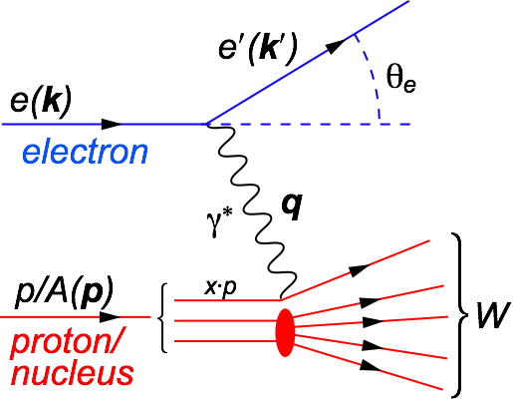
Deep Inelastic Scattering (DIS)
DIS:
As a probe, electron beams provide unmatched precision of the electromagnetic interaction
Direct, model independent, determination of kinematics of physics processes
x:
y:
s:
Q²:
square of center-of-mass energy of electron-hadron system
Bjorken-x
x is fraction of the nucleon’s momentum carried by the struck quark
0 < x < 1
squared momentum transfer from scattered electron
Virtuality
“Resolution” power
Inelasticity
Fraction of electron’s energy lost in nucleon restframe
0 < y < 1
s: center-of-mass energy squared
Q²: resolution power
x: momentum fraction of parton
y: inelasticity
Notes:
W2 can also be interpreted as the center-of-mass energy of the gauge boson nucleon system.
Q2 max = s
Q2: negative square of the momentum transfer q, denotes virtuality
x: make Remark that for e+p 0 < x < 1 while for e+A scattering 0 < x < A.
y: is the fraction of the lepton’s energy lost in the nucleon rest frame. It it thus also the fraction of the incoming electron energy (also known as inelasticity) carried by the exchange boson (photon) in the rest frame of the nucleon
Q^2 &=& -q^2 = - (k-k^\prime)^2 \\
&\approx& 4 E E^\prime \sin^2\left(\frac{\theta}{2}\right)

Slide 3
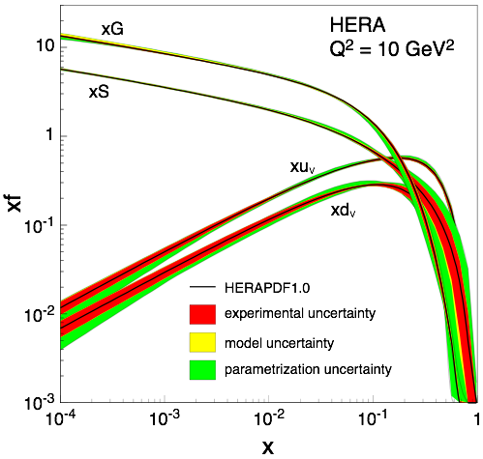
EIC: The Physics Program
Investigate with precision the universal dynamics of gluons and sea quarks that fundamentally make up nearly all the mass of the visible universe
All strongly interacting matter is an emergent consequence of many-body quark-gluon dynamics.
Example: Mass from massless gluons and (nearly) massless quarks
Understanding the origins of matter demands that we develop a deep and varied knowledge of this emergent dynamics
gluon dominated
Two branches ⇒ polarized ep and eA

Slide 4
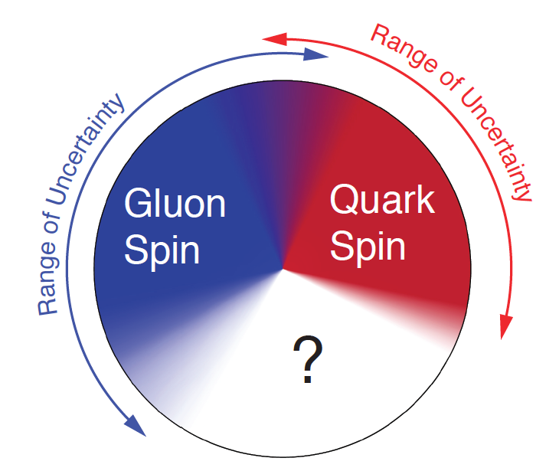
Key Topic in ep: Proton Spin Puzzle
What are the appropriate degrees of freedom in QCD that would explain the “spin” of a proton?
After 20 years effort
Quarks (valence and sea): ~30% of proton spin in limited range
Gluons (latest RHIC data): ~20% of proton spin in limited range
Where is the rest?
It is more than the number ½! It is the interplay between the intrinsic properties and interactions of quarks and gluons
Notes:
If we do not understand the proton spin, we don’t understand QCD

Slide 5
Driving Fundamental Questions in ep
How do quark and gluon dynamics generate the proton spin?
What is the role of the orbital motion of sea quarks and gluons in building up the nucleon spin?
How are the sea quarks and gluons distributed in space and transverse momentum inside the nucleon?
How are these distributions correlated with overall nucleon properties, such as spin direction?

Slide 6
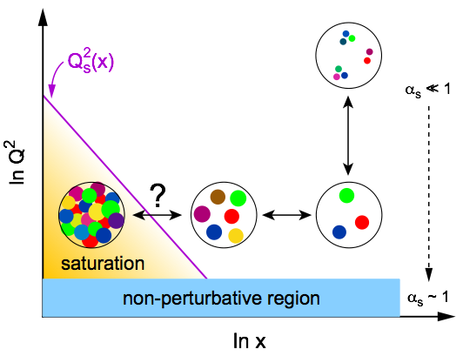
Key Topic in eA: Gluon Saturation (I)
Is the proton a runaway popcorn machine at high energies ?
In QCD, the proton is made up of quanta that fluctuate in and out of existence
Boosted proton:
Fluctuations time dilated on strong interaction time scales
Long lived gluons can radiate further small x gluons…
Explosion of gluon density ⇒ violates unitarity
pQCD
evolution
equation
New Approach: Non-Linear Evolution
New evolution equations at low-x & low to moderate Q²
Saturation of gluon densities characterized by scale Q_{s}(x)
Wave function is Color Glass Condensate

Slide 7
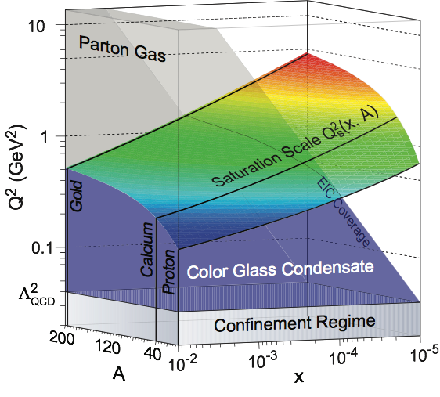
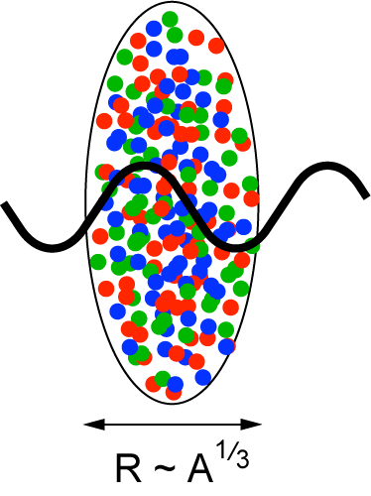
Key Topic in eA: Gluon Saturation (II)
Enhancement of Q_{S} with A: saturation regime reached at significantly lower energy in nuclei (and lower cost)

Slide 8
Driving Fundamental Questions in eA
Nucleus
serves as:
What is the fundamental quark-gluon structure of atomic nuclei?
Can we experimentally find and explore a novel universal regime of strongly correlated QCD dynamics?
What is the role of saturated strong gluon fields, and what are the degrees of freedom in this strongly interacting regime?
Can the nuclear color filter provide novel insight into propagation, attenuation and hadronization of colored probes?
⎧
⎨
⎩
Object of
Interest
⎧
⎪⎪⎨
⎪⎪⎩
Amplifier
⎧
⎪⎨
⎪⎩
Analyzer

Slide 9
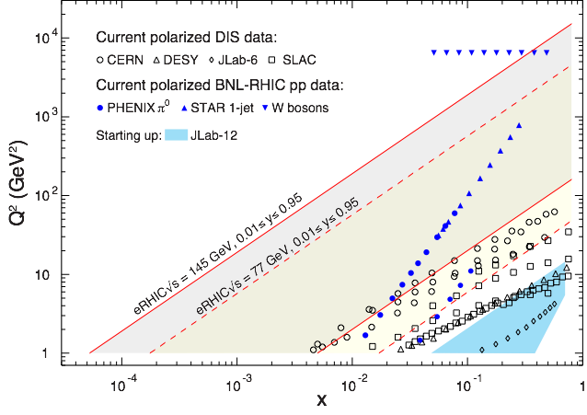
Requirements: √s and Polarization
polarized
ep, μp, pp
Need to reach low-x where gluons dominate (∆G, ∆Σ range!)
Flexible energies (see also structure functions later)
Need sufficient lever arm in Q² at fixed x (evolution eq. along Q² or x)
Electrons and protons/light nuclei (p, He³ or D) highly polarized (70%)
Notes:
Mention importance of Q2 lever arm at fixed x
fixed target experiments limited in kinematic coverage

Slide 10
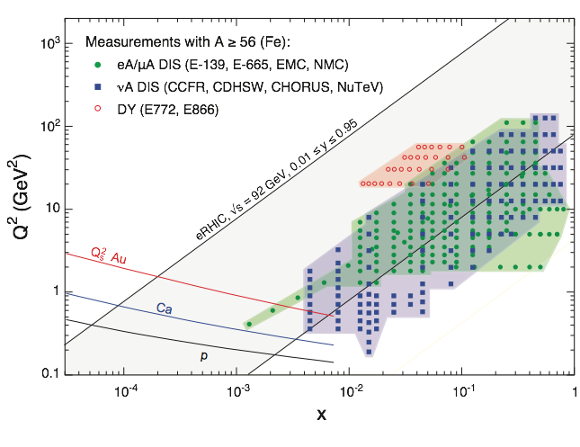
Requirements: √s and Beam Masses
eA, μA, νA
(A ≥ Fe)
Large Q², large ν
Hadronization
Energy-Loss
Low-x
Saturation
Saturation physics needs low-x reach and wide range of nuclei (A dependence) up to the heaviest A (Qs enhancement): d ➟ U
Need sufficient lever arm in Q² up to at least x = 10⁻³ to verify non-linear evolution equations of CGC

Slide 11
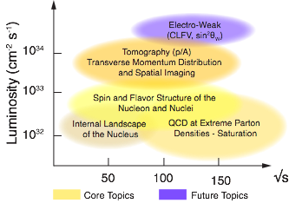
Requirements: Luminosity & Detector
High Luminosity ~ 10³³ cm⁻²s⁻¹ and higher
Requirement affected by binning (N-differential distribution always more powerful the higher N) ⇔ close collaboration with theory
Affected by systematic uncertainties dominated by luminosity and polarization measurements (use past and existing facilities as a guide, e.g. HERA)
Detector to explore full capabilities
with good PID (e/h and π, K, p)
wide acceptance to reach edges of kinematic range
See talk by Elke

Slide 12
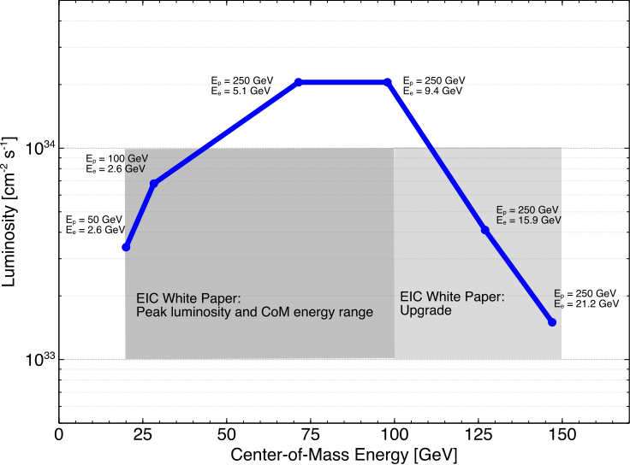
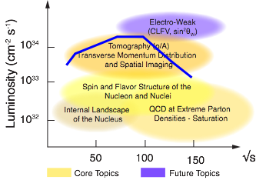
eRHIC: A Design that Matches Physics Goals
Ions: d up to U
Polarization ~70%/80%
for eA: EA = Ep*Z/A, L ∝ 1/A

Slide 13
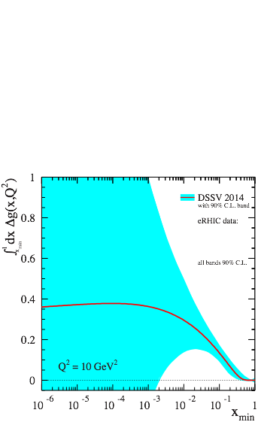
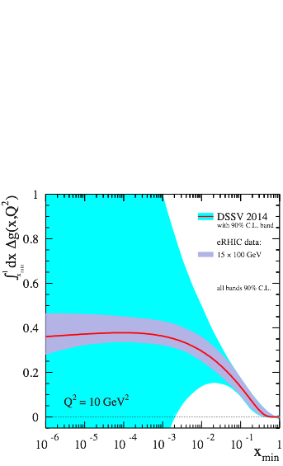
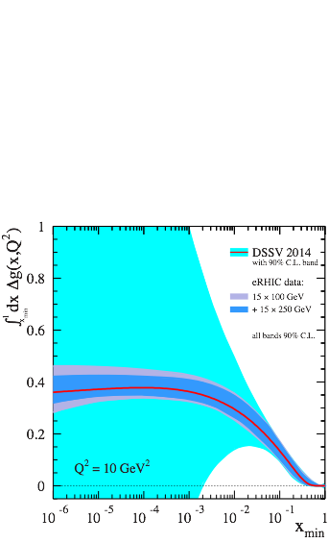
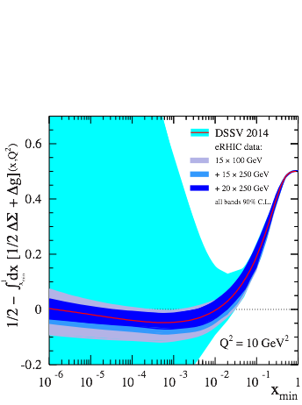
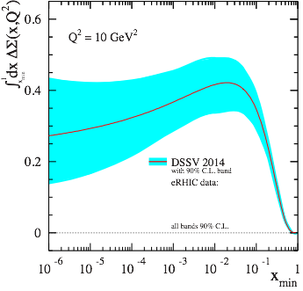
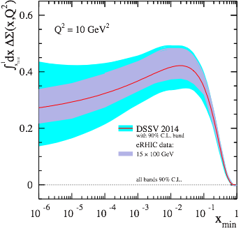
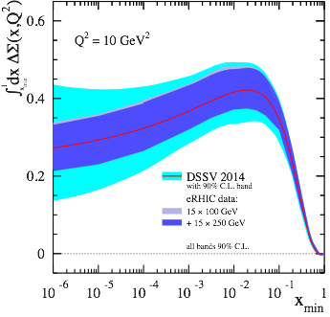
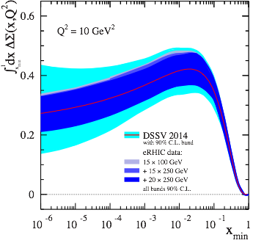
eRHIC: Longitudinal Spin of the Proton (I)
Inclusive Measurement:
e+p → e′+X
Quark Spin
Gluon Spin
½-Gluon-Quark Spin
Leading Order:
(Quark Spin)
Combining information on ∆Σ and ∆g constrains angular momentum
Higher Order:
(Gluon Spin)
For ∫Ldt = 10 fb⁻¹ and 70% polarization
Current knowledge (DSSV): uses strong theoretical constraints
eRHIC projections do not ⇒ test w/o assumptions
Notes:
Mention: not even sign of L is constraint
polarized
gluon Δg(x,Q2) and quark Δq(x,Q2) distribution
Figure 2-5 shows the running integral
!"!ΔΣ(!, !!) !!!"#, which represents the contribution of all quark flavors to the spin of the proton
experimental access to the ∆f in lepton- scattering is obtained through the spin-dependent structure function g1(x,Q2), which ap- pears in the polarization difference of cross sections when the lepton and the nucleon collide with their spins anti-aligned or aligned:

Slide 14
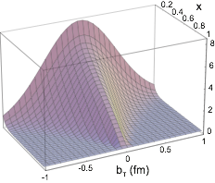
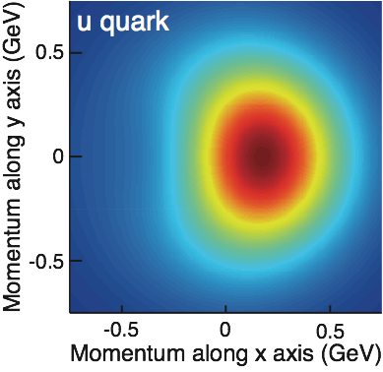
3D Imaging at eRHIC: TMDs & GPDs
Transverse Momentum Distributions (TMDs):
2D+1 picture in momentum space (kT)
Generalized Parton Distributions (GPDs):
2D+1 picture in coordinate space (bT)
Study through azimuthal asymmetries in semi-inclusive DIS
Requires π/K/p PID
Study through exclusive processes (DVCS, diffraction, VM production)
Luminosity hungry
S
⊕
z
Notes:
The density in the transverse-momentum plane for unpolarized quarks with x = 0:1
in a nucleon polarized along the ^y direction. The anisotropy due to the proton polarization is
described by the Sivers function, for which the model of [77] is used. The deep red (blue)
indicates large negative (positive) values for the Sivers function.
Impact parameter dependent parton distribution u(x, b?) for the simple model
First, there is a general decrease in magnitude with increasing x ,
which arises mostly due to the decrease of q (x ). Furthermore, one can also a notice
a decreasing transverse width of the distribution q (x, b⊥ ) as x increases, which is
in accord with our general prediction

Slide 15
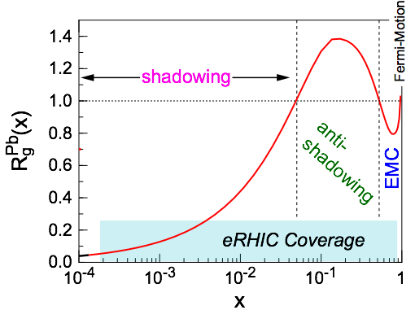
eRHIC: Nuclear Structure Functions (I)
Inclusive DIS on eA:
quark+anti-quark
gluon
F2 and FL are benchmark measurements:
Theory/models have to be able to describe the structure
functions and their evolution.
Leading twist pQCD models parameterize the observed suppression of the structure function with decreasing x using nuclear parton distribution functions (nPDFs)
Aim at extending our knowledge on structure functions into the realm where gluon saturation effects emerge
Notes:
\frac{d^2 \sigma^{eA\rightarrow eX}}{dx dQ^2} = \frac{4 \pi \alpha^2}{x Q^4} \left[ \left(1-y+\frac{y^2}{2}\right) {\color{blue}F_2(x, Q^2)} - \frac{y^2}{2} {\color{red}F_L(x, Q^2)}\right]

Slide 16
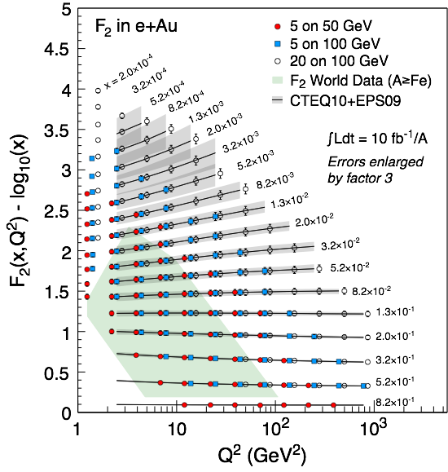
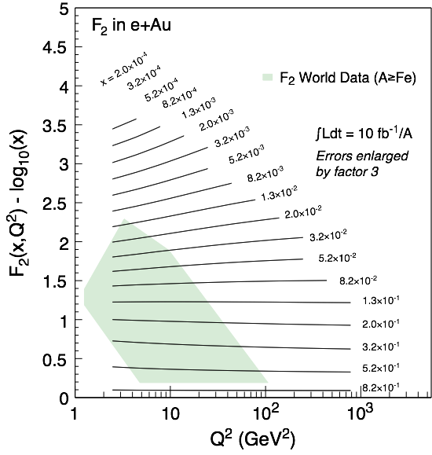
eRHIC: Nuclear Structure Functions (II)
Assume 3% systematic uncertainty
Systematic uncertainties dominate, not L hungry
Good lever arm at x~10⁻³
Also studied:
FL
statistics hungry
requires runs at various √s
F2,charm
provides compelling alternative to FL , sensitive to glue
Notes:
\frac{d^2 \sigma^{eA\rightarrow eX}}{dx dQ^2} = \frac{4 \pi \alpha^2}{x Q^4} \left[ \left(1-y+\frac{y^2}{2}\right) {\color{blue}F_2(x, Q^2)} - \frac{y^2}{2} {\color{red}F_L(x, Q^2)}\right]

Slide 17
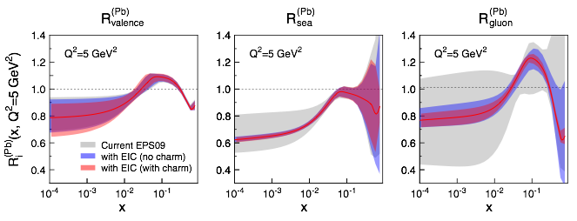
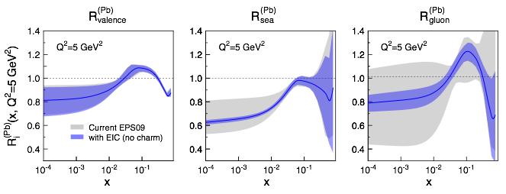
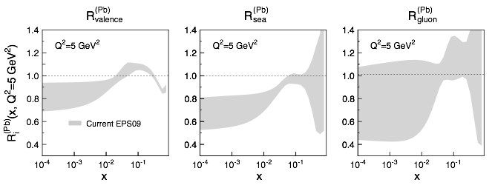
eRHIC: Impact on Knowledge on nPDFs
Ratio of PDF(Pb)/PDF(p)
Without EIC, large uncertainties for sea quarks and gluons
Adding in EIC, pseudo-data significantly reduces the uncertainties, particularly at small-x
Fitting the charm pseudo-data has a dramatic effect at high-x
Something pA at RHIC & LHC will not be able to address

Slide 18
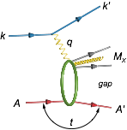
eRHIC: Diffractive Events in eA
Diffractive physics will be a major component of the eA program at an EIC
High sensitivity to gluon density: σ~[g(x,Q²)]² due to color-neutral exchange
Only known process where spatial gluon distributions of nuclei can be extracted
2 Types: Coherent (A stays intact) & Incoherent (A breaks up)
Experimental challenging to identify
Rapidity gap ⇒ hermetic detector
Breakup needs to be detected ⇒ n and γ in Zero Degree Calorimeter, spectator tagging (Roman Pots), IR design!
See also talks by Vadim and Elke
Notes:
HERA: σdiff/σtot ~ 15%

Slide 19
eRHIC: Spatial Gluon Distribution from dσ/dt
1950-60: Measurement of charge (proton) distribution in nuclei
Ongoing: Measurement of neutron distribution in nuclei
EIC ⇒ Gluon distribution in nuclei
Fourier Transform
Method:
Diffractive vector meson production:
e + Au → e′ + Au′ + J/ψ, φ, ρ
incoherent
Momentum transfer t = |pAu-pAu′|² conjugate to bT
coherent
PRC 87 (2013) 024913
dσ/dt: diffractive pattern known from wave optics
φ sensitive to saturation effects, smaller J/ψ shows no effect
J/ψ perfectly suited to extract source distribution
Converges to input F(b) rapidly: |t| < 0.1 almost enough
Recover accurately any input distribution used in model used to generate pseudo-data (here Wood-Saxon)
Systematic measurement requires ∫Ldt >> 1 fb⁻¹/A
Notes:
spin-dependent gluon distribution

Slide 20
Summary
eRHIC, with its high energy, high luminosity eA and polarized ep collisions, will provide answers to long-standing fundamental questions in QCD
ep: Precision studies of structure functions, TMDs, and GPDs will lead to the most comprehensive picture of the nucleon ever: its flavor, spin, and spatial structure
eA: Unprecedented study of matter in a new regime of QCD. New capabilities open a new frontier to study the saturation region, measure the gluonic structure of nuclei, and investigate color propagation, and fragmentation using the nucleus as analyzer.
eRHIC: Provides unique capabilities for the study of QCD well beyond those available at existing facilities worldwide. Its design matches the physics goals in all aspects, allowing us to study the broad range of topics detailed in the EIC White Paper.

